Slide 1
GPK.Battles Game
Testing Report
Abhijit Roy

Slide 2
Content
Run-1
Run-2
Run-3

Slide 3
Workflow
START
transfer desired cards to escrow contract
ACTION -> `simpleassets::transfer`
Select cards for playing
Reason: Ensure `game_fee` in `gfeewallet` table
---------------------------------------------------------------------
Solution: transfer min. required `game_fee` from `eosio.token::accounts` table
ACTION -> `eosio.token::transfer`
ACTION -> `gpkbattlesco::sel3card`
play
During 1st trial
If (1st trial & 1-Draw): 1 time draw
Both players get 1 last chance to select cards & play again for free
From Table | To Table
eosio.token::accounts | gpkbattlesco::gfeewallet
ACTION -> `gpkbattlesco::play`
No Draw
1-Draw
ACTION ->
`gpkbattlesco::receiverand`
During 2nd trial
After both players select cards
After no players select cards
After 1 player select cards
Disburse nodraw cards
ACTION ->
`gpkbattlesco::disndcards`
ACTION ->
`gpkbattlesco::del1drawgame`
ACTION ->
`gpkbattlesco::del1drawgame`
2-Draw
END

Slide 4
RUN-1
Case-3: nodraw

Slide 5
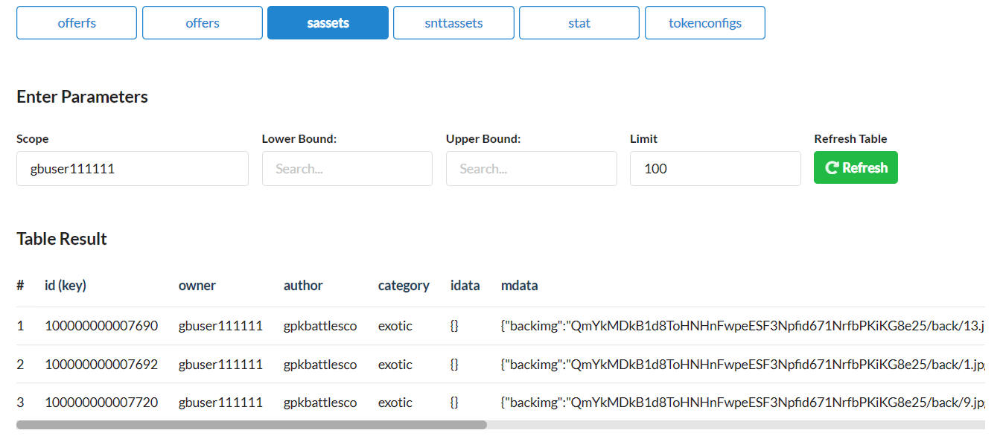
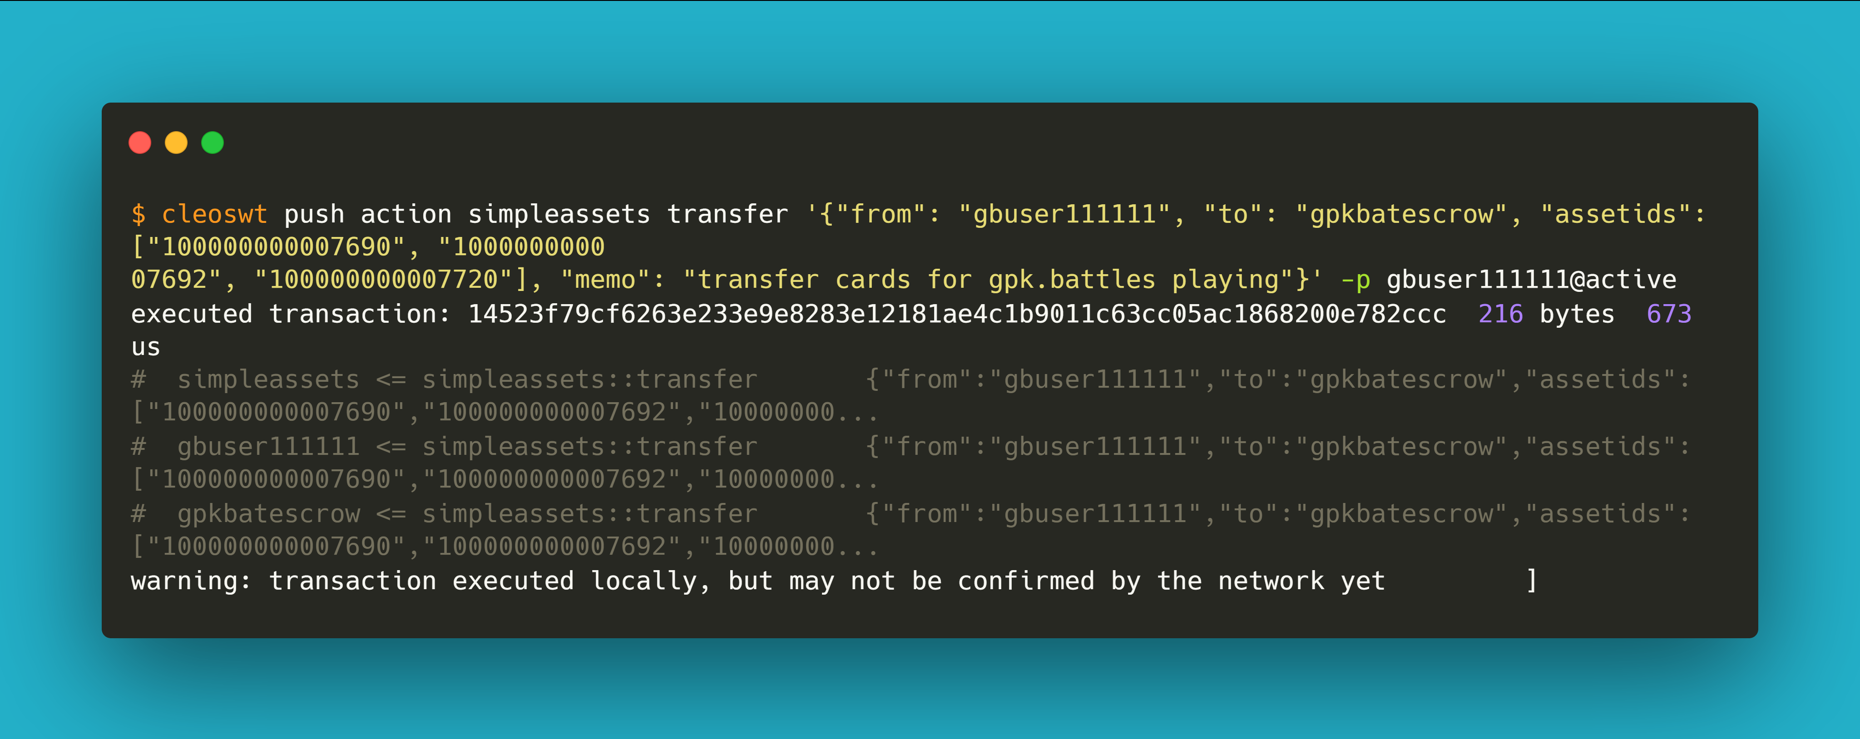
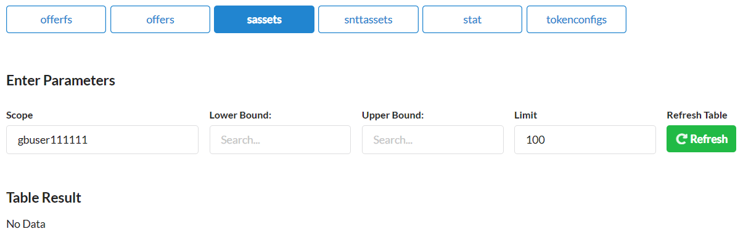
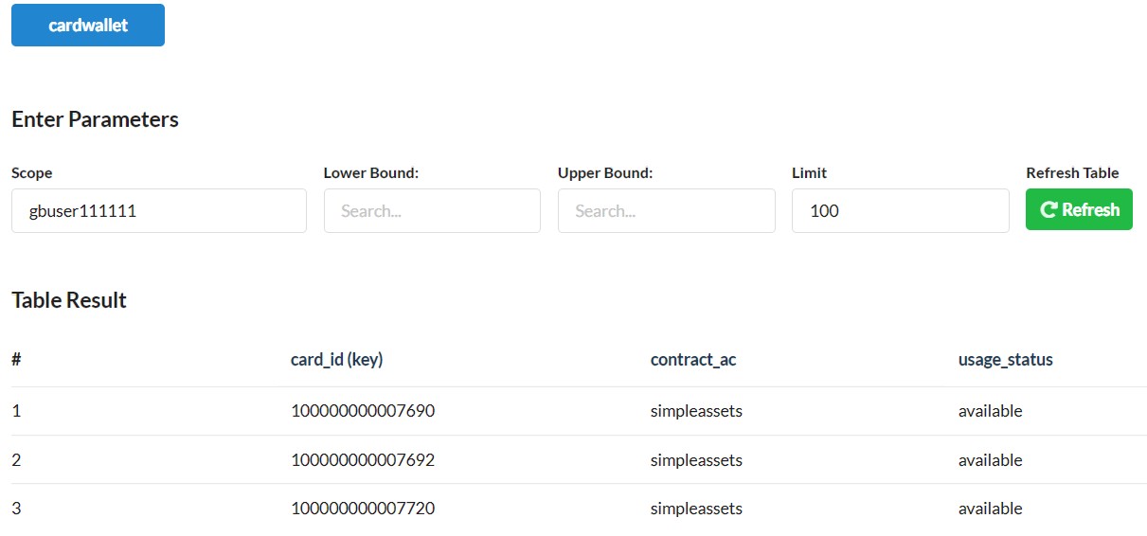
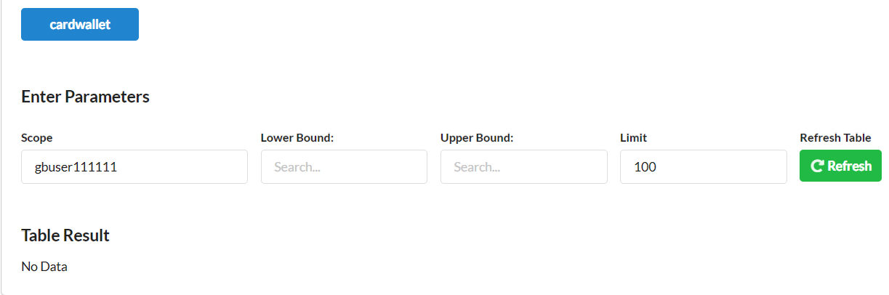
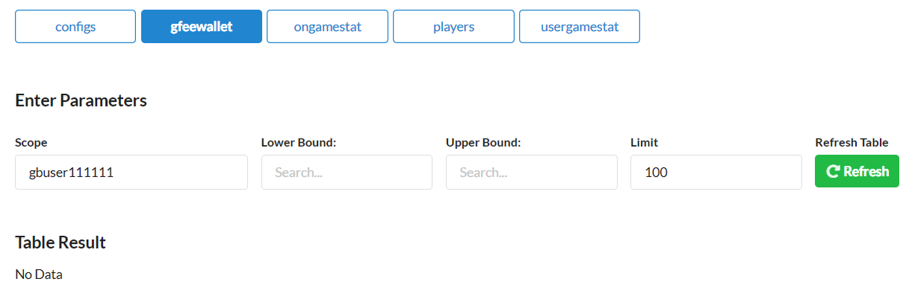
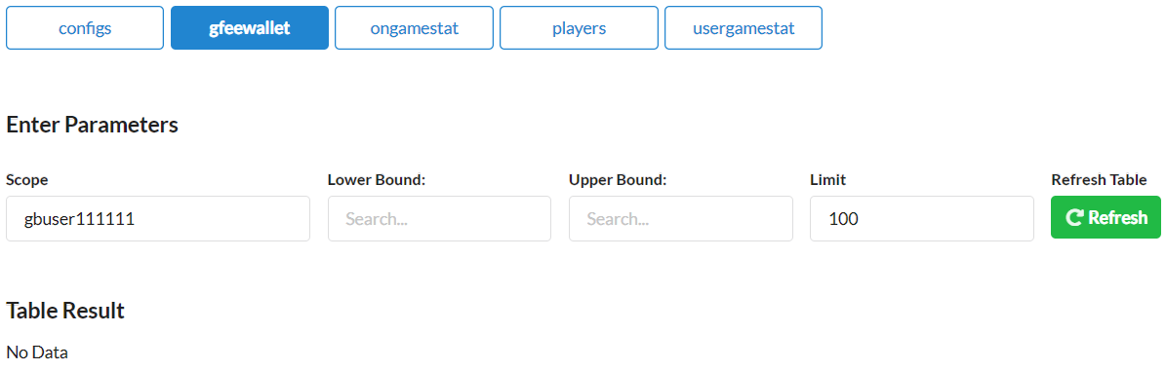
1.
gbuser111111
transfer desired cards to escrow contract
gpkbatescrow
Pre
Activity
Post
sassets
sassets
cardwallet
cardwallet
gfeewallet
gfeewallet

Slide 6
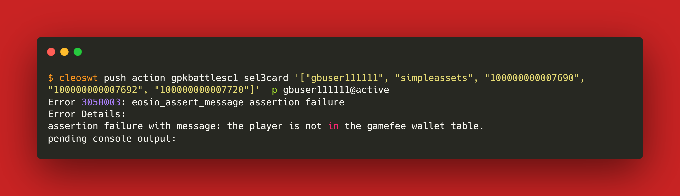
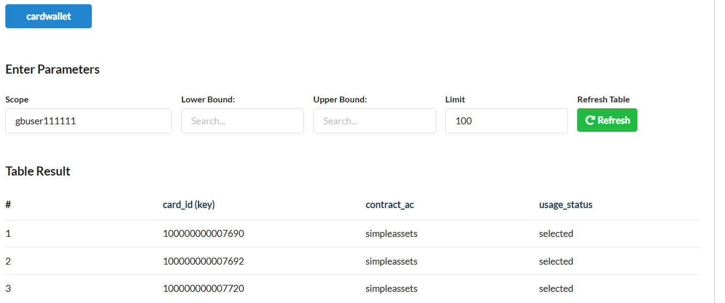
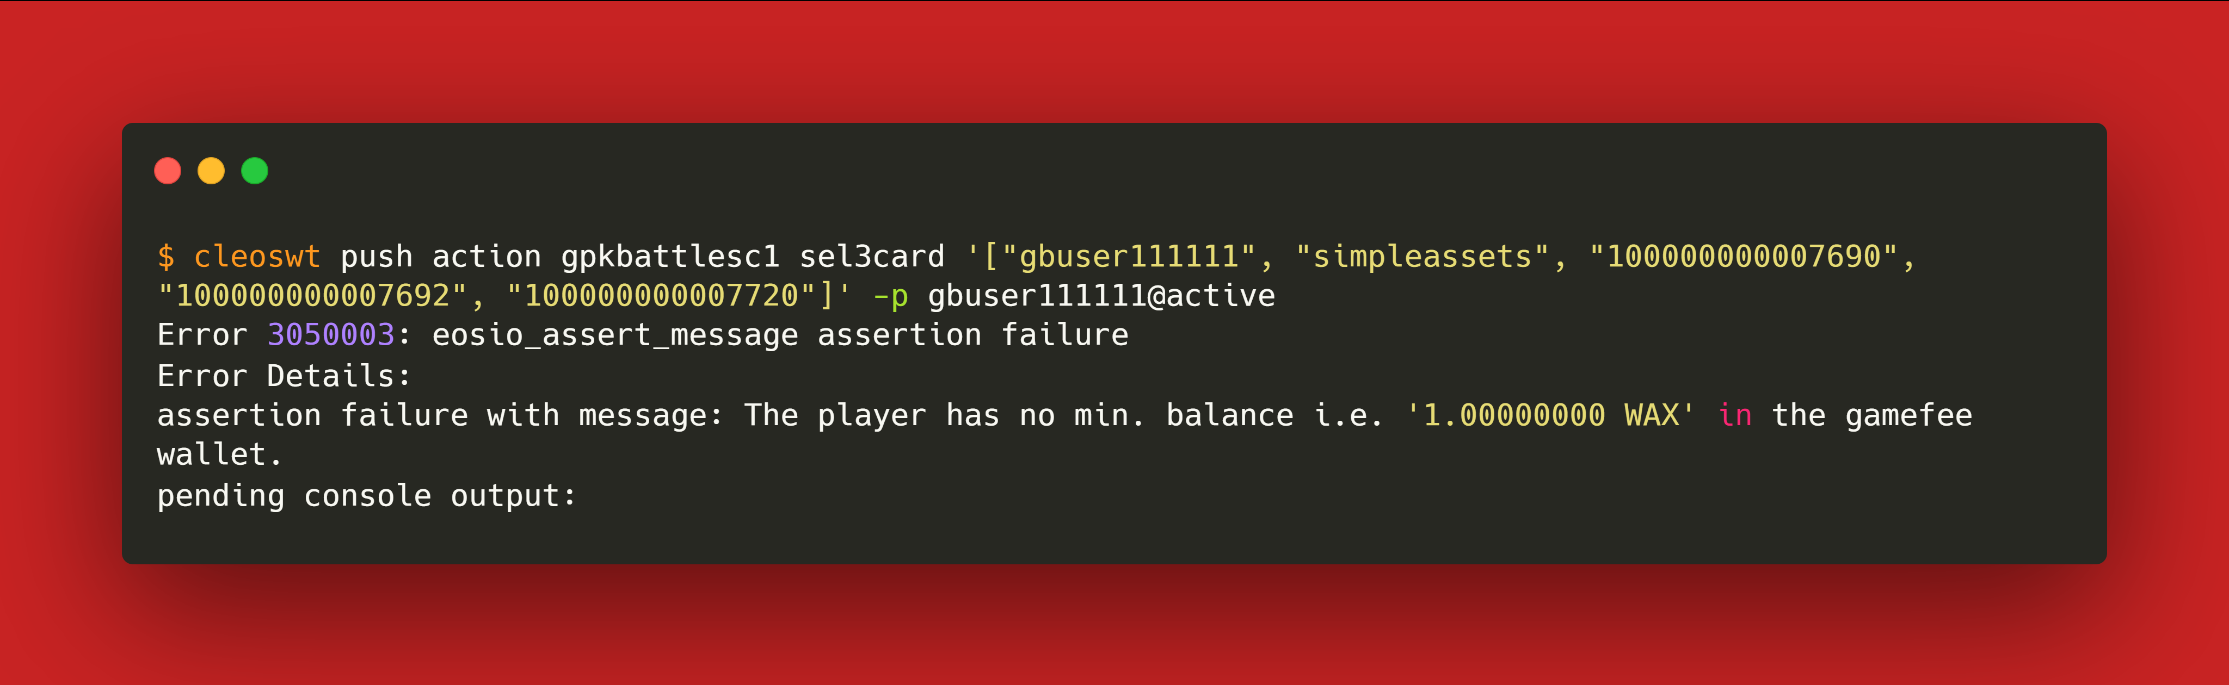
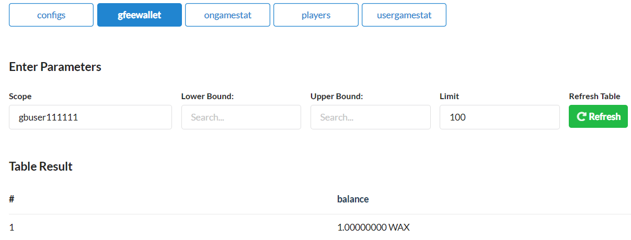
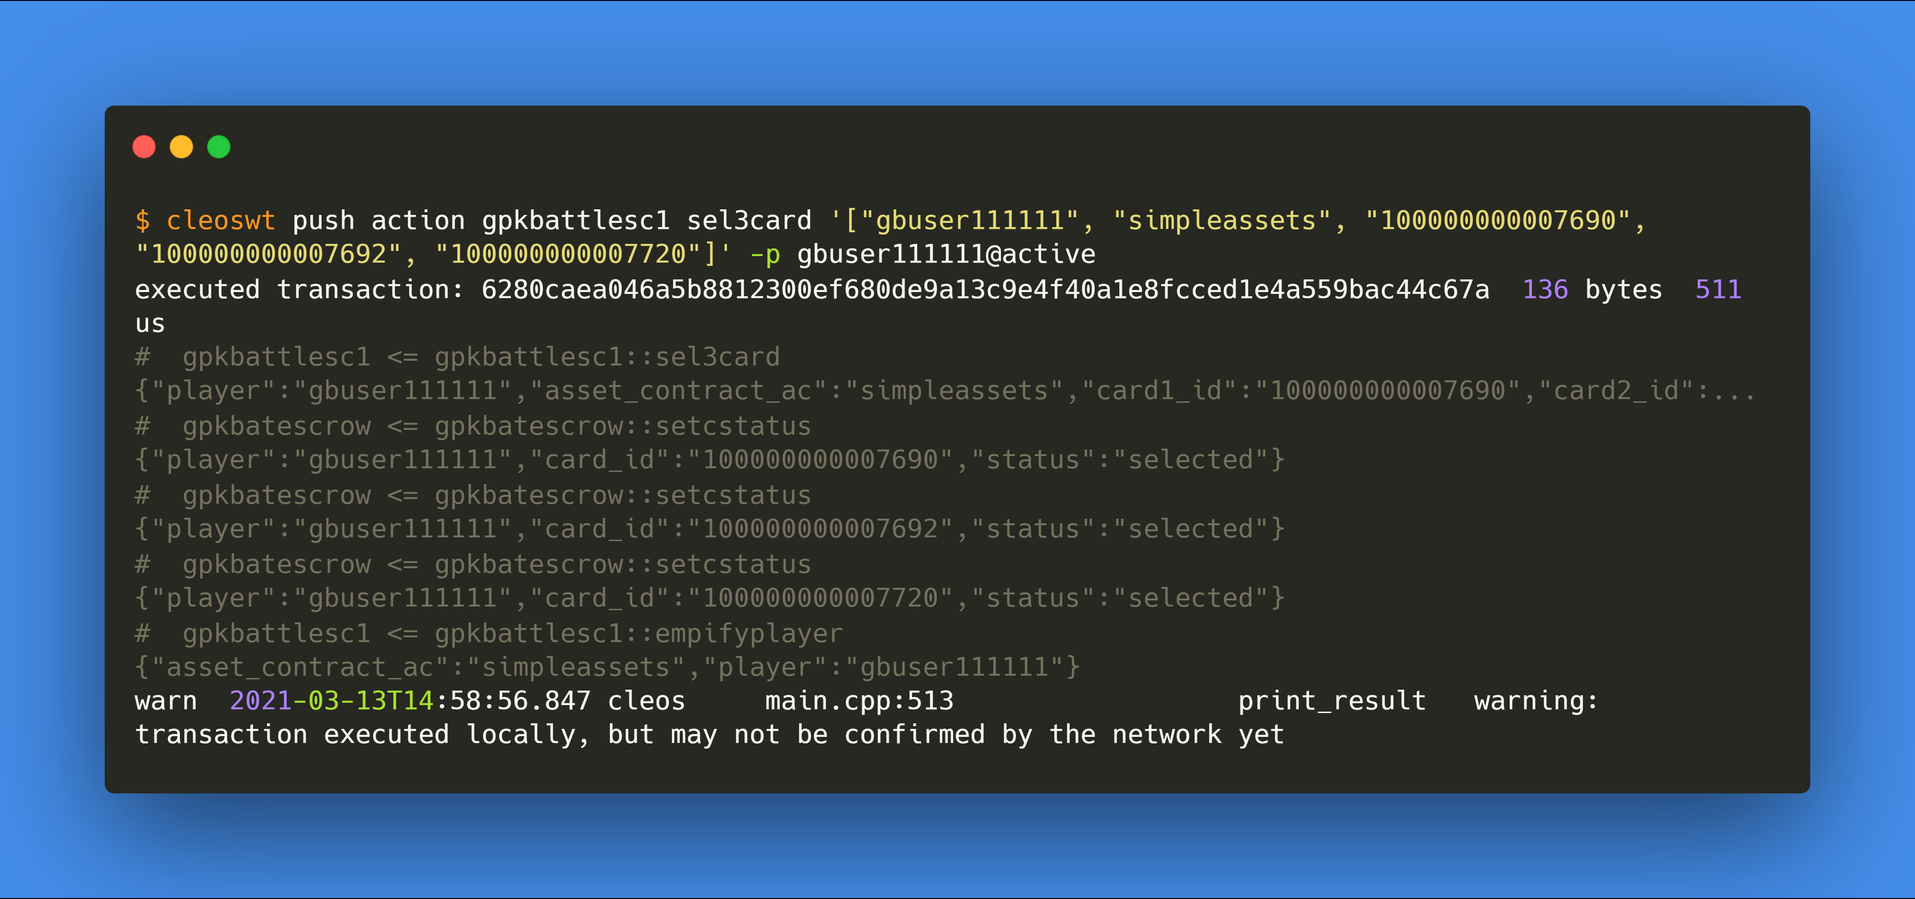
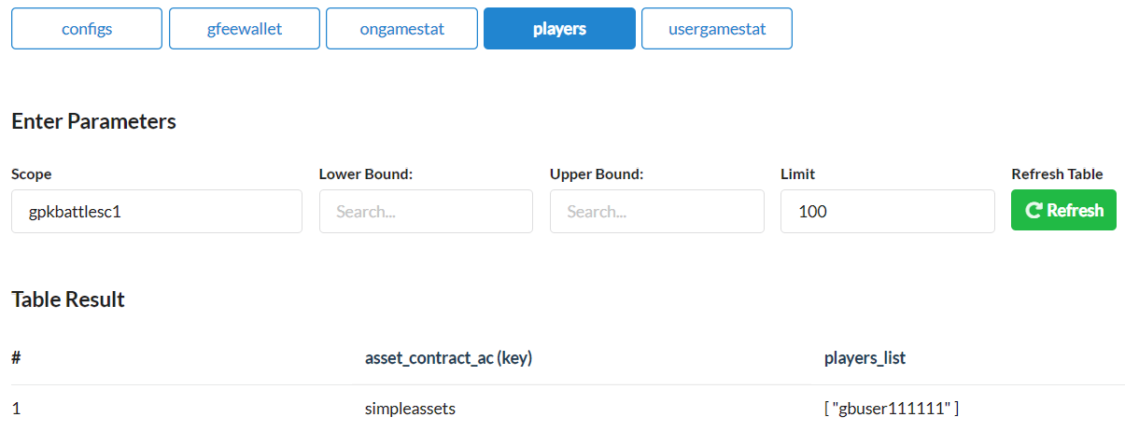
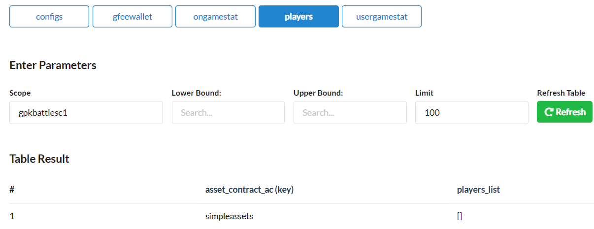
2.
gbuser111111
select 3 cards
Pre
Activity
Post
cardwallet
cardwallet
gfeewallet
gfeewallet
players
players

Slide 7
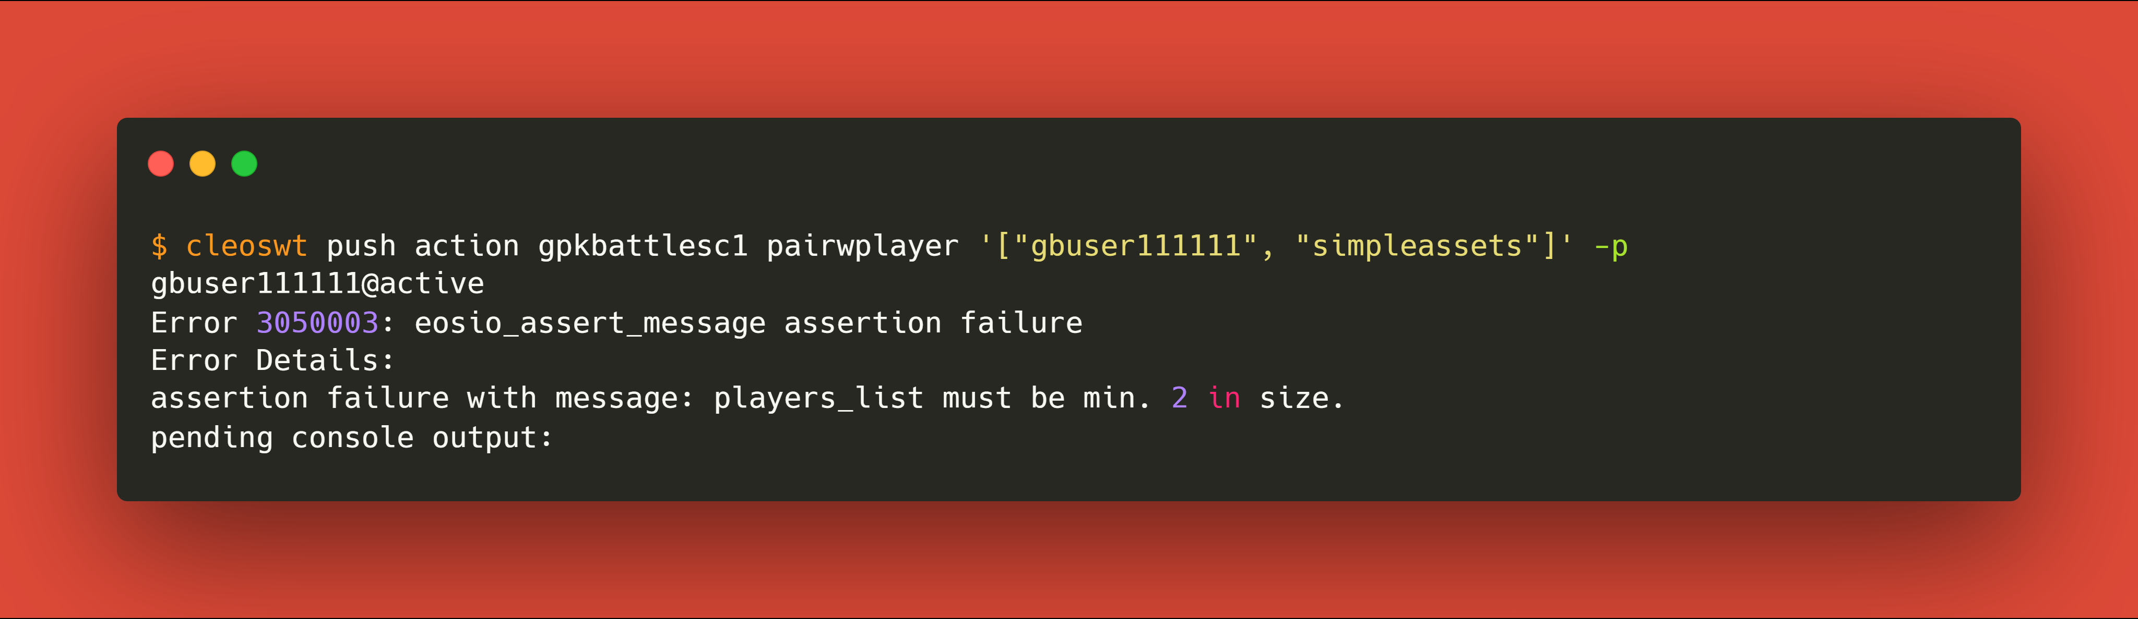
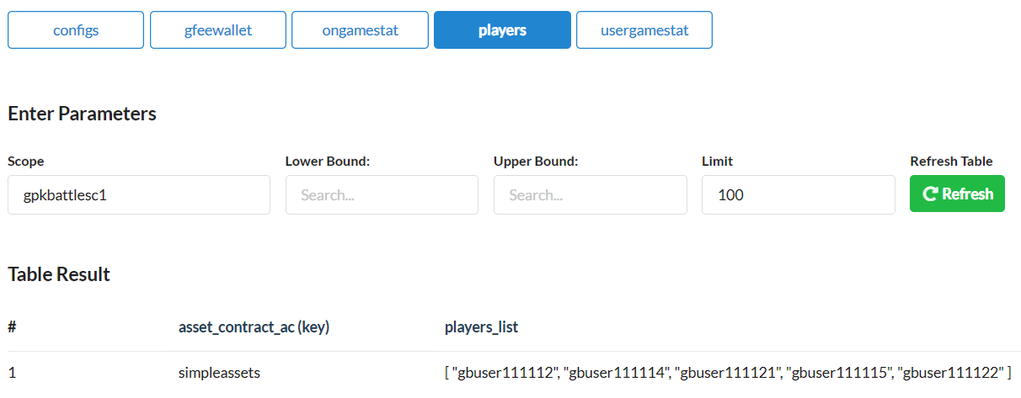
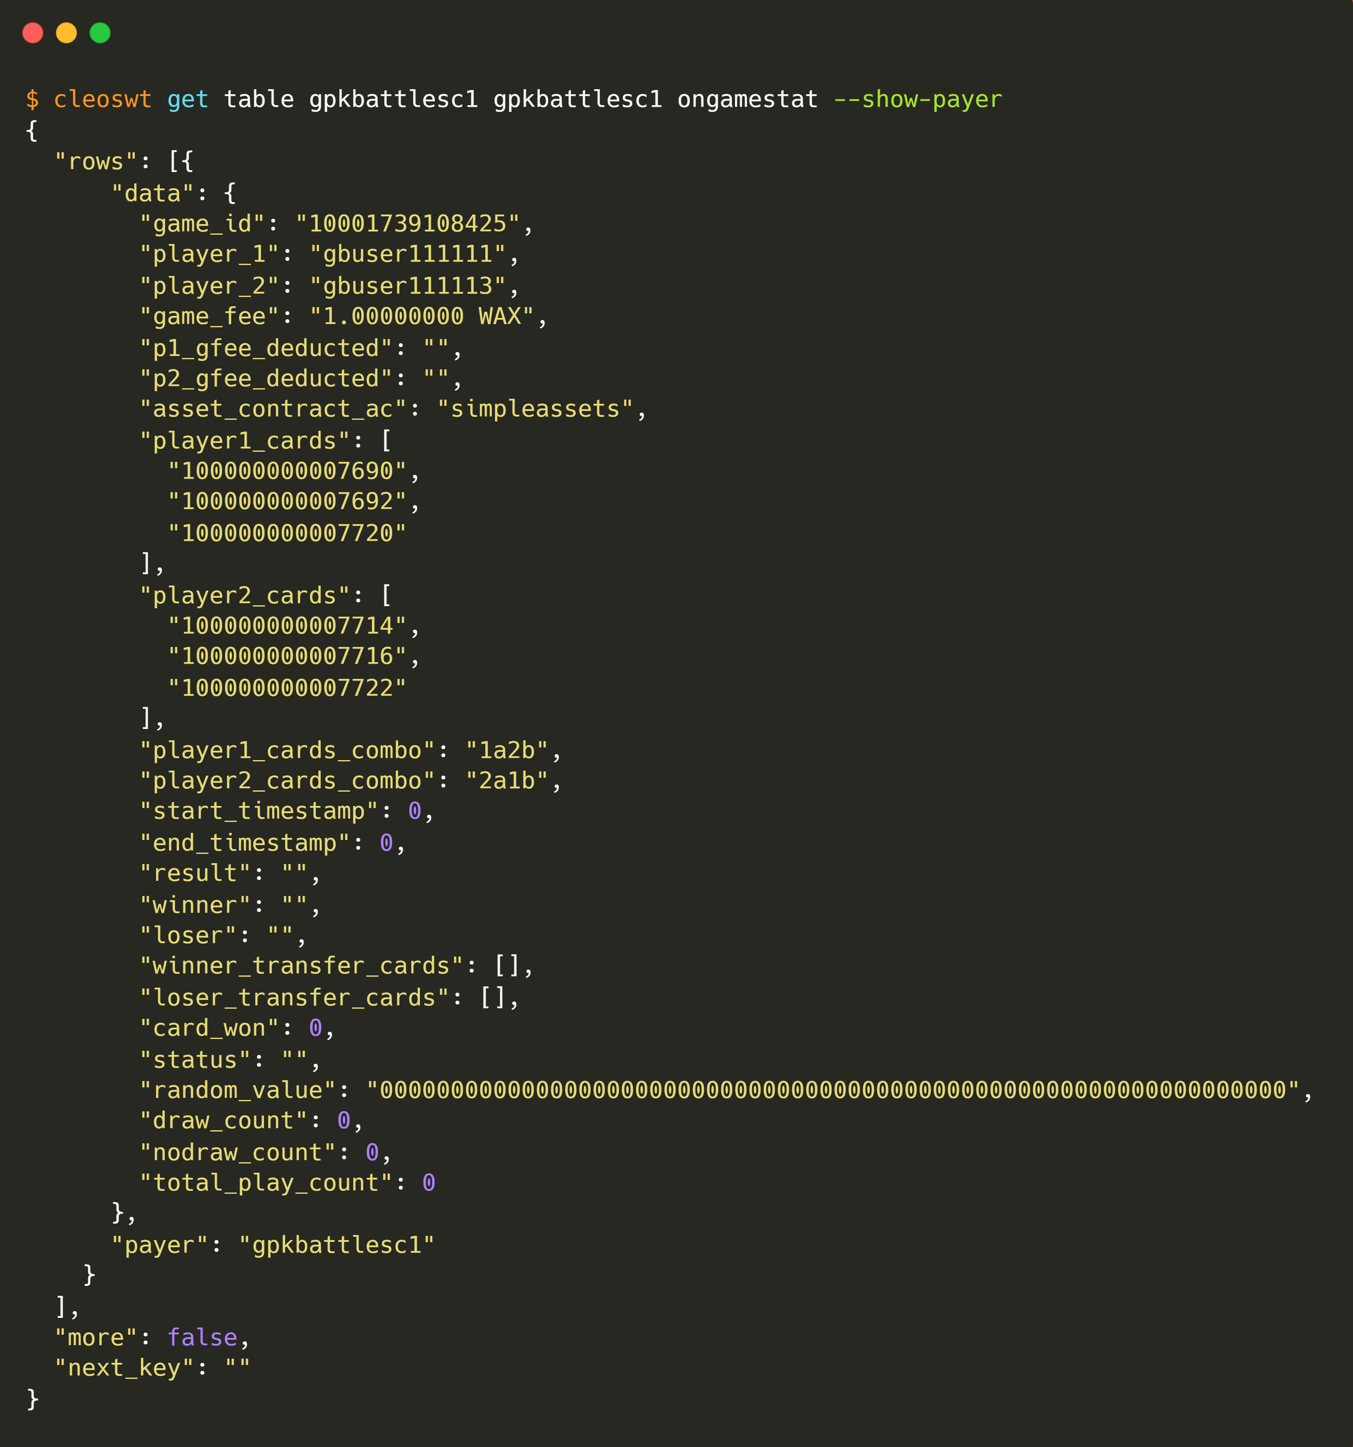
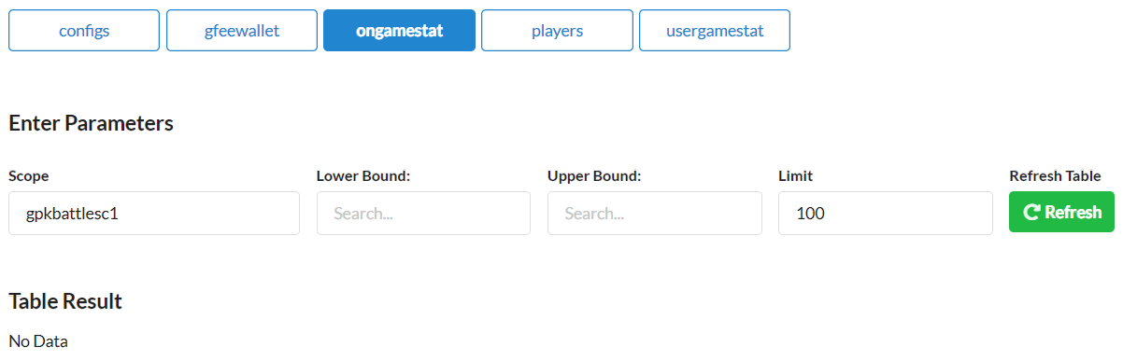
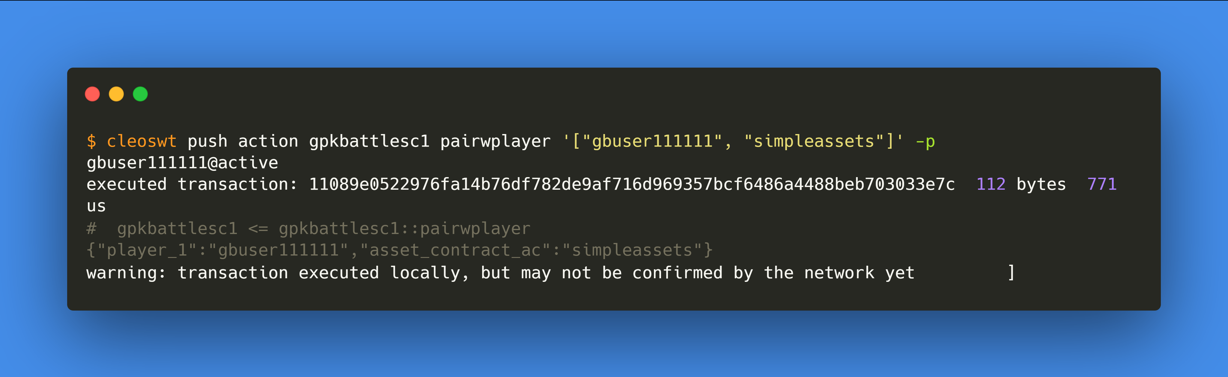
3.
gbuser111111
pairs with a player
Pre
Activity
Post
players
players
ongamestat
ongamestat
gfeewallet
gfeewallet

Slide 8
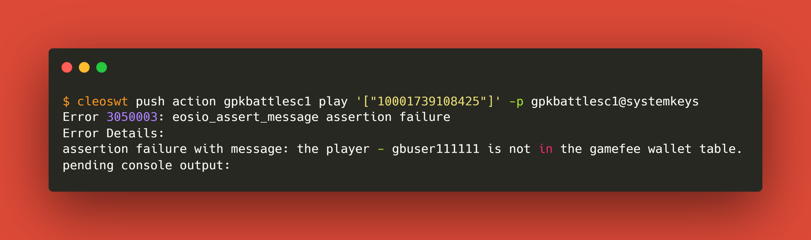
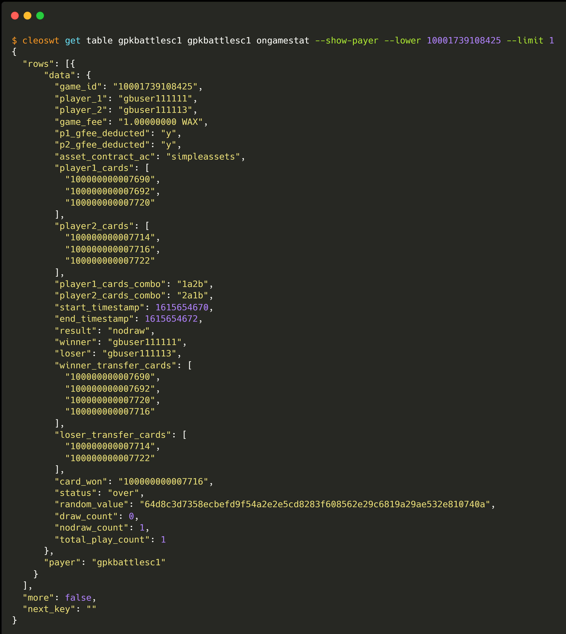

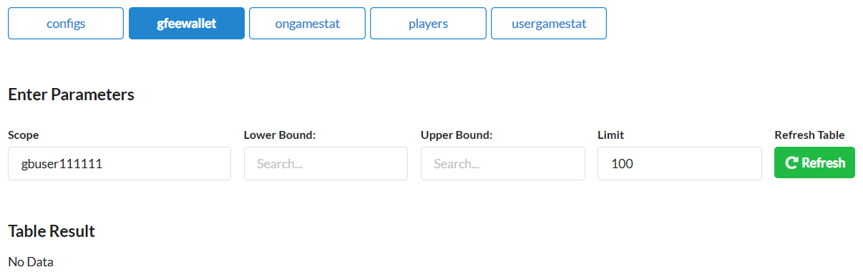
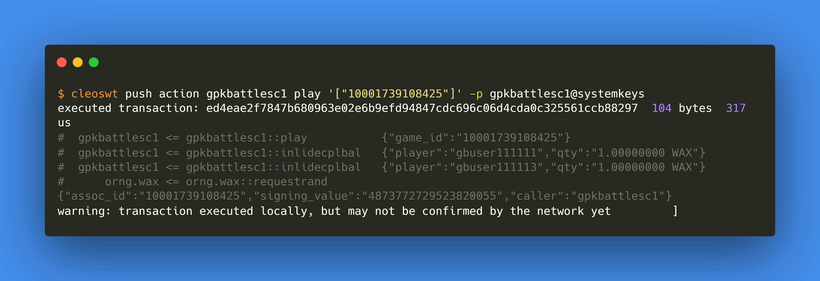
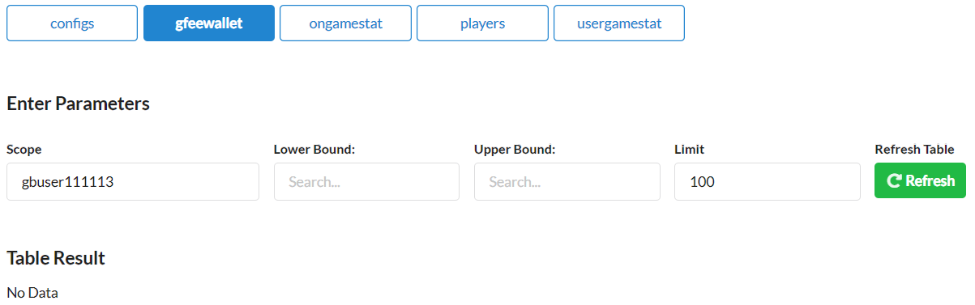
4.
gbuser111111
plays
Pre
Activity
Post
ongamestat
ongamestat
gfeewallet
gfeewallet

Slide 9
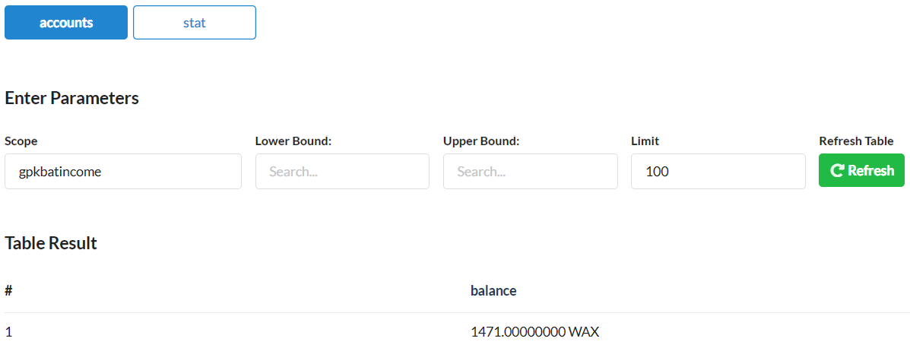
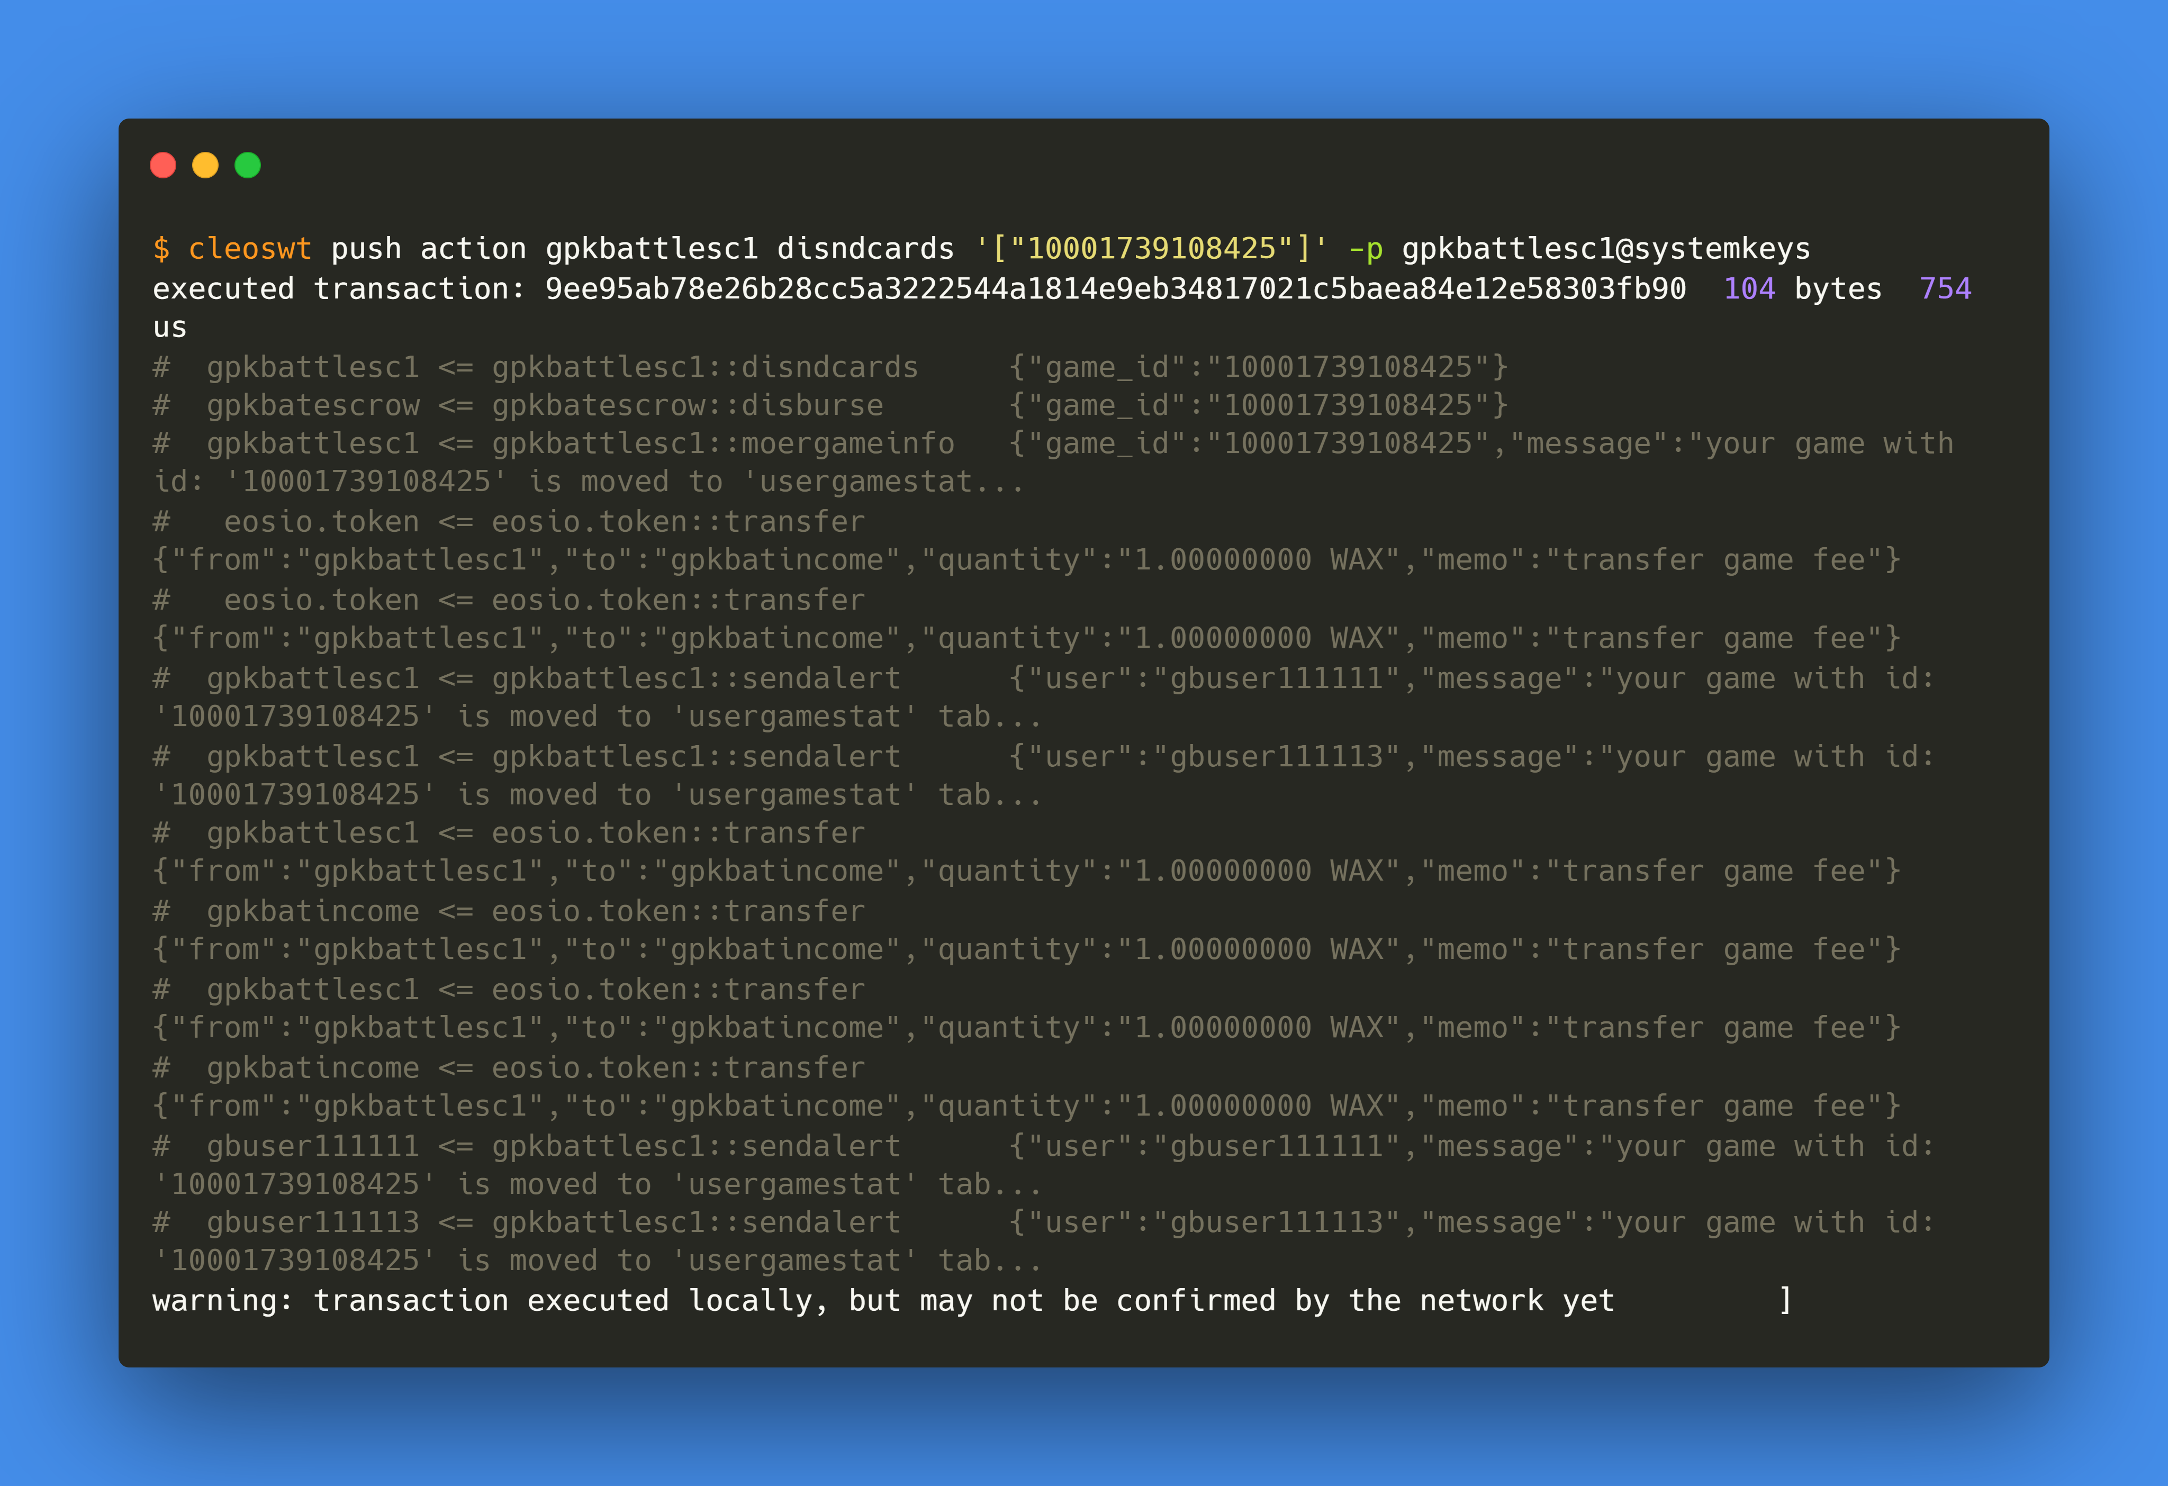
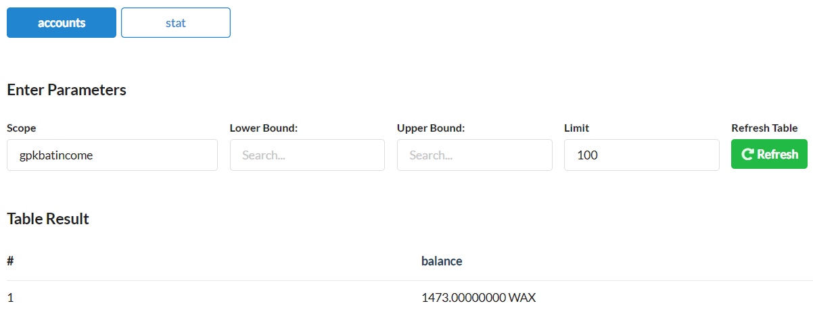
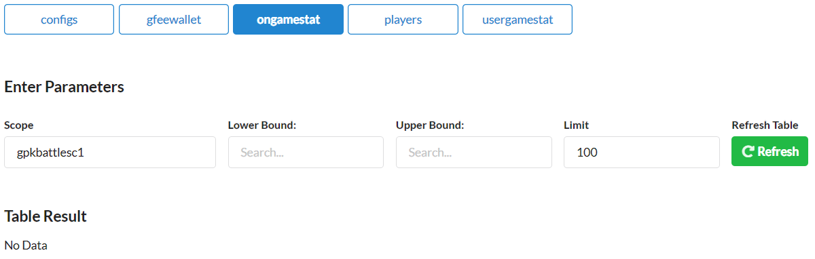
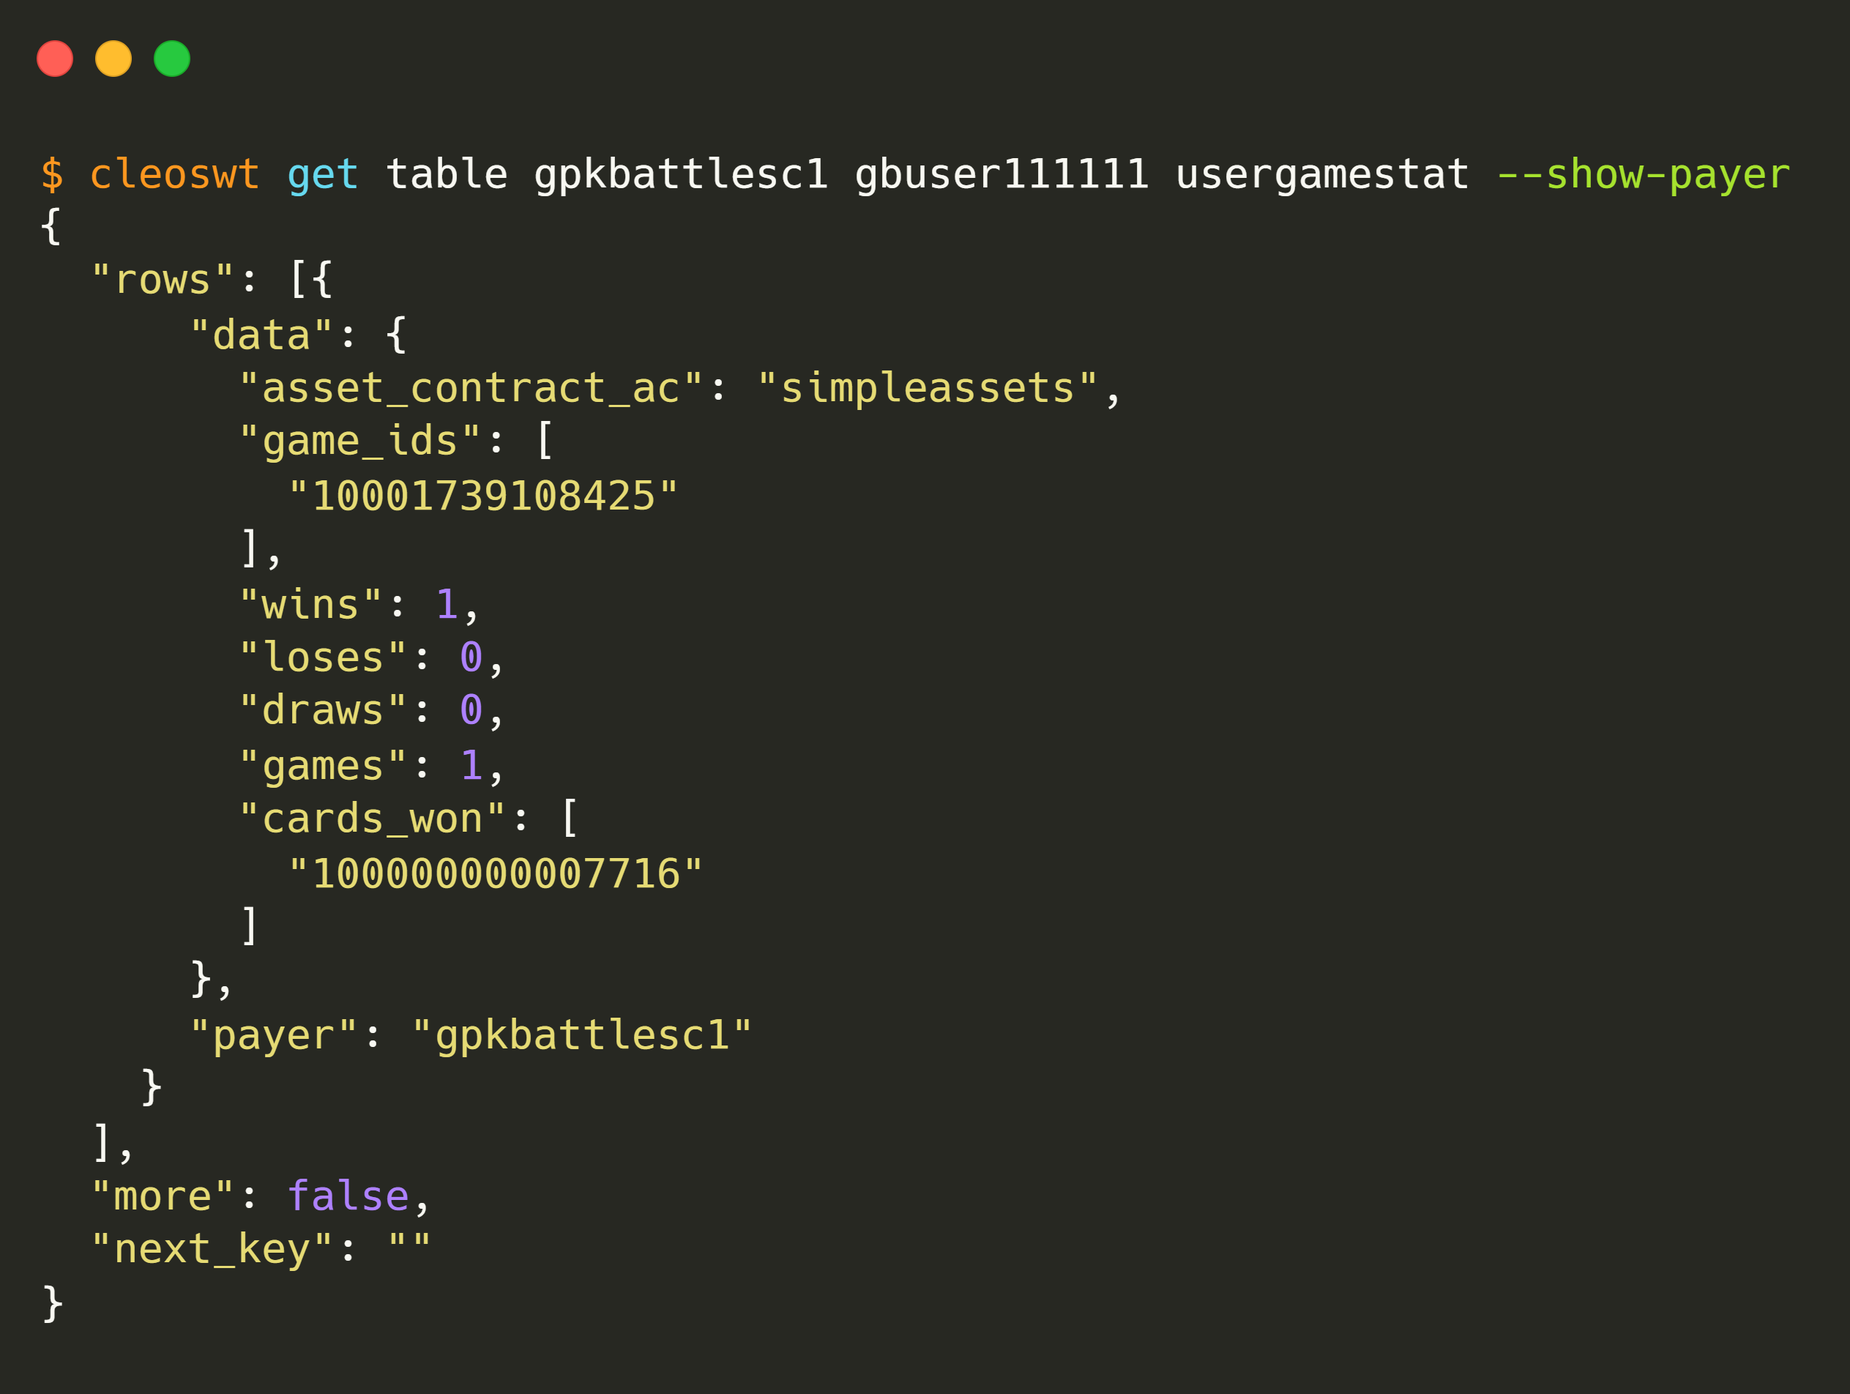
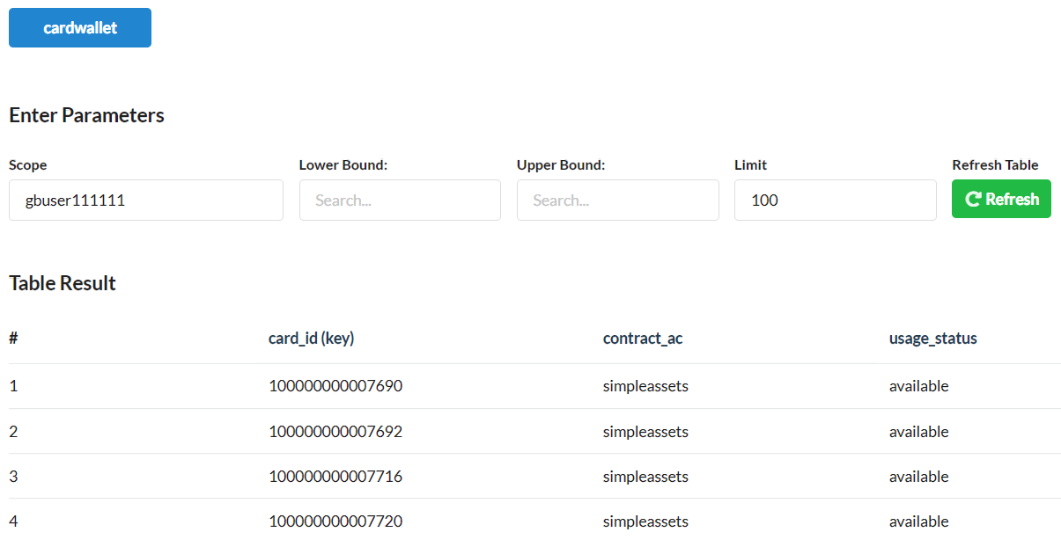
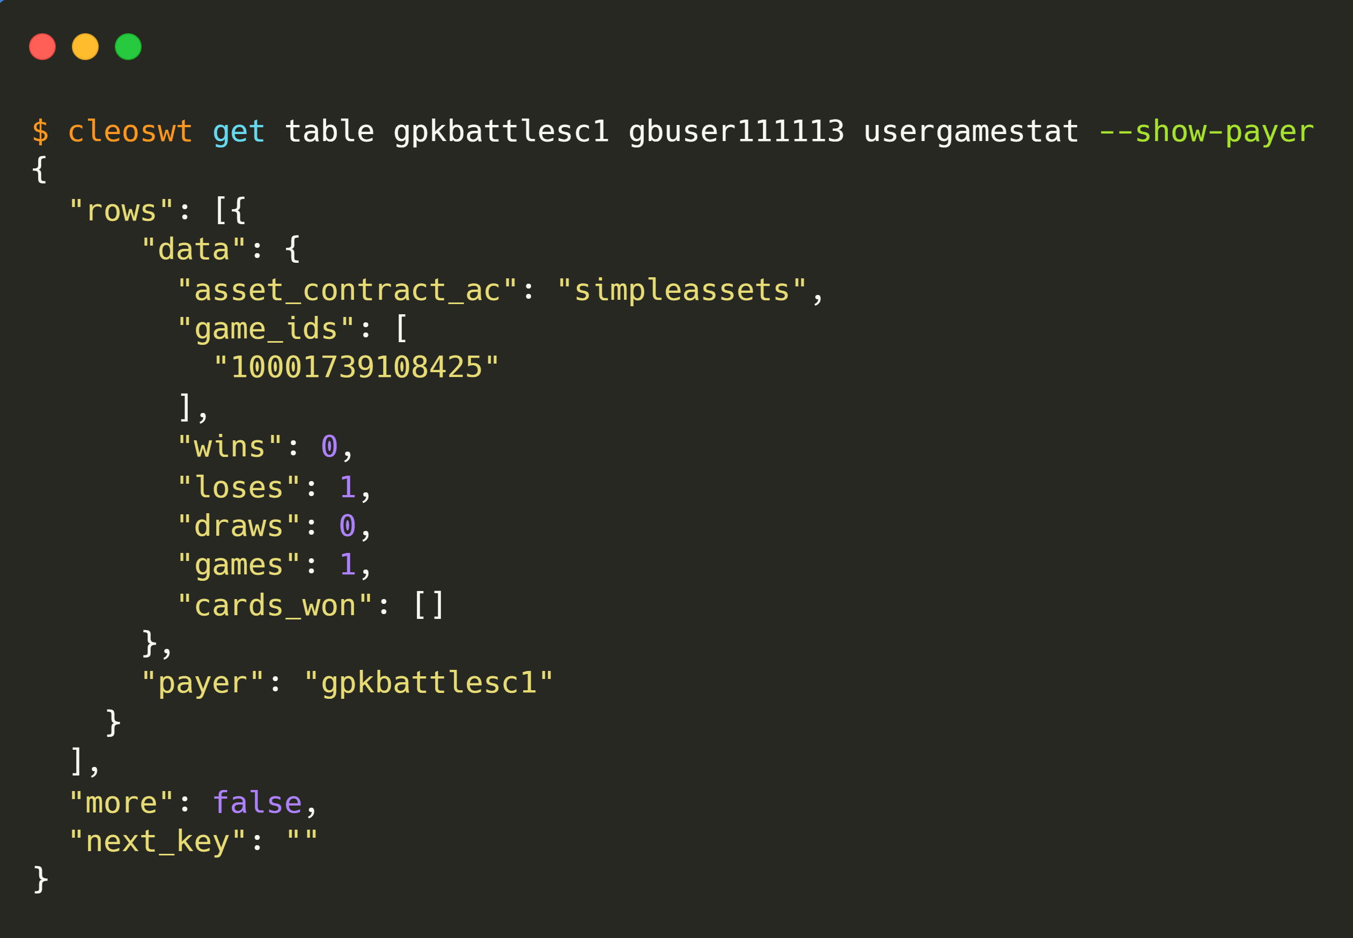
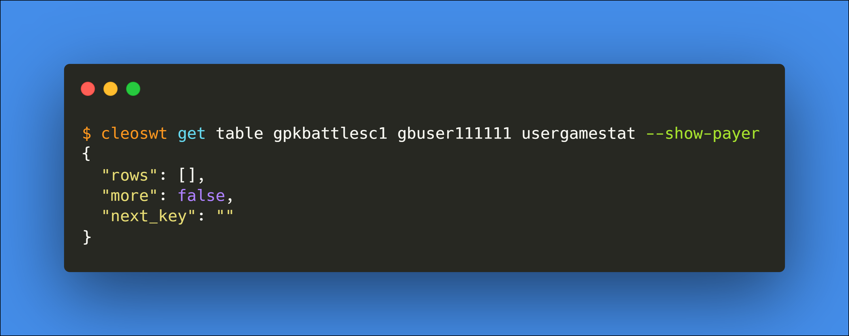
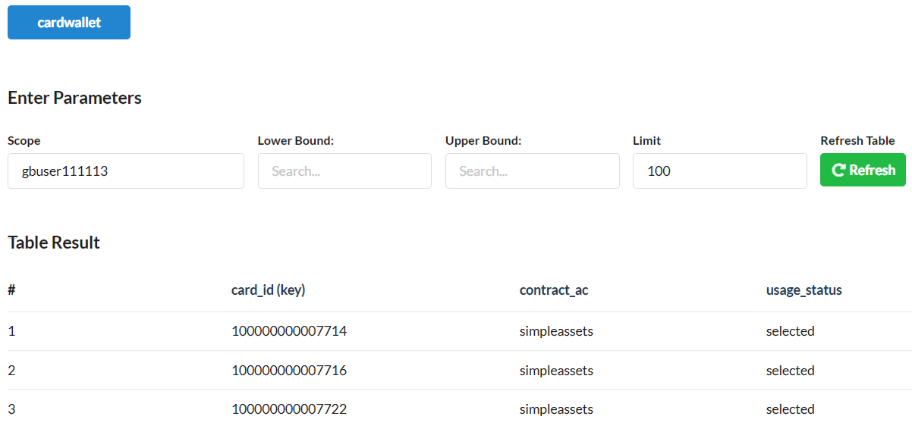

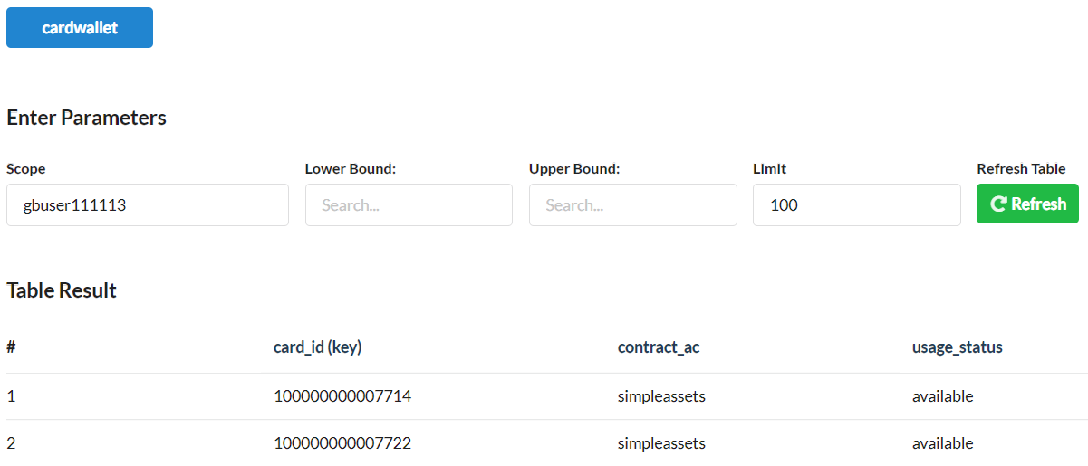
5.
Disburse nodraw cards by
gpkbattlesco
contract account
Pre
Activity
Post
ongamestat
accounts
ongamestat
accounts
players
players
usergamestat
cardwallet
cardwallet
usergamestat

Slide 10
RUN-2
Case-3: nodraw

Slide 11

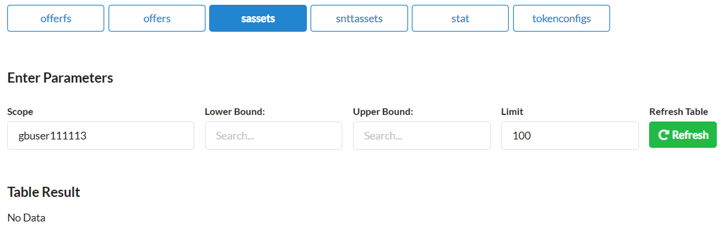
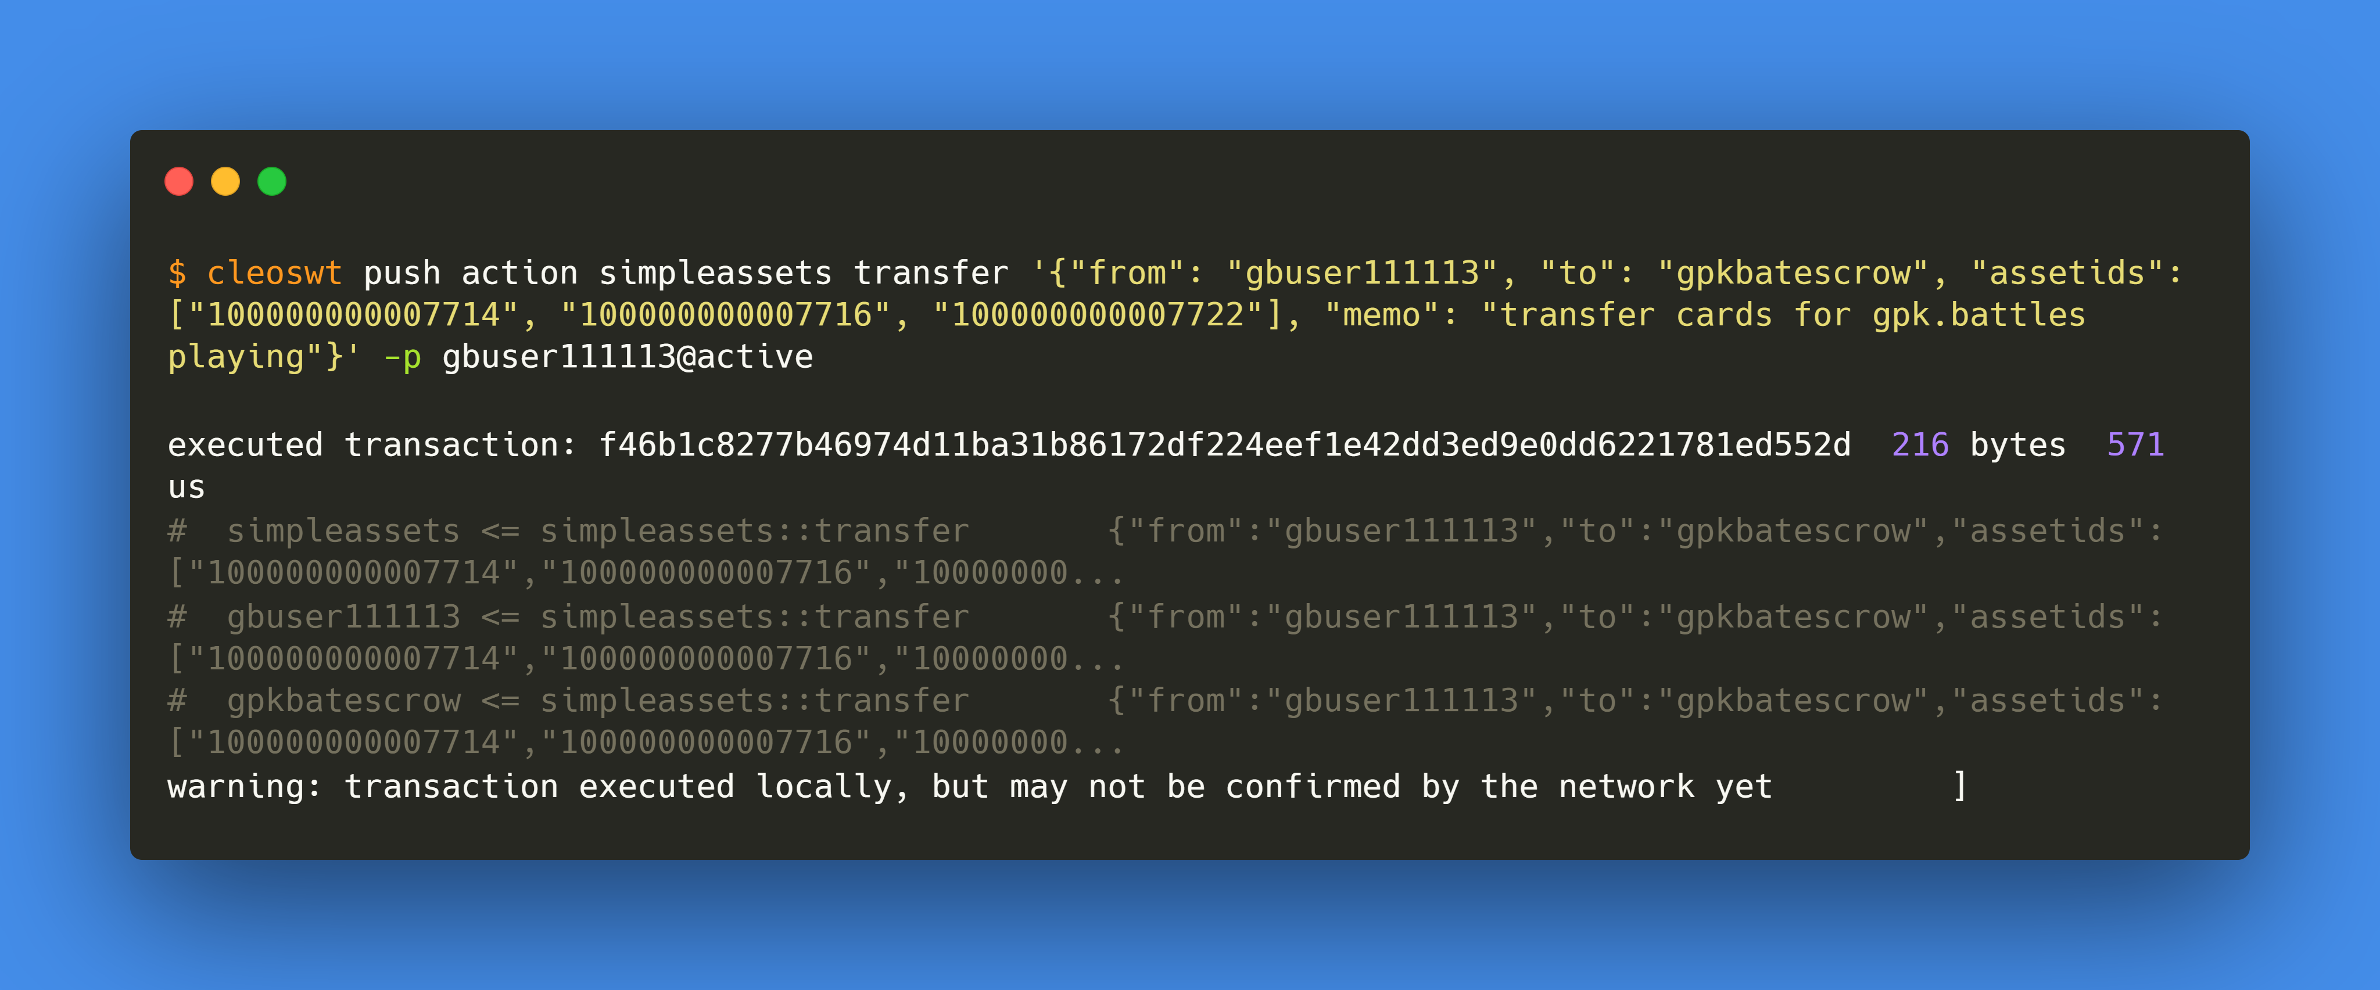
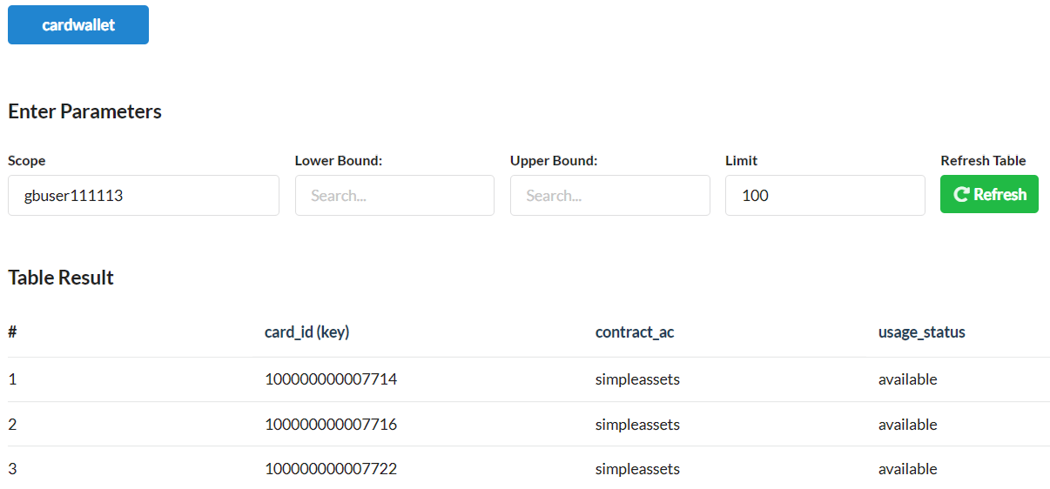
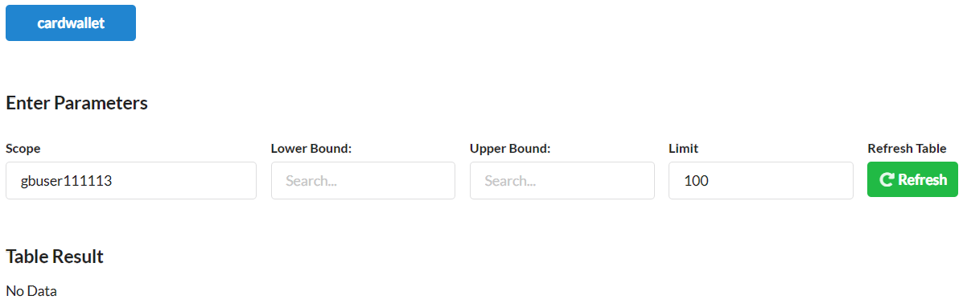
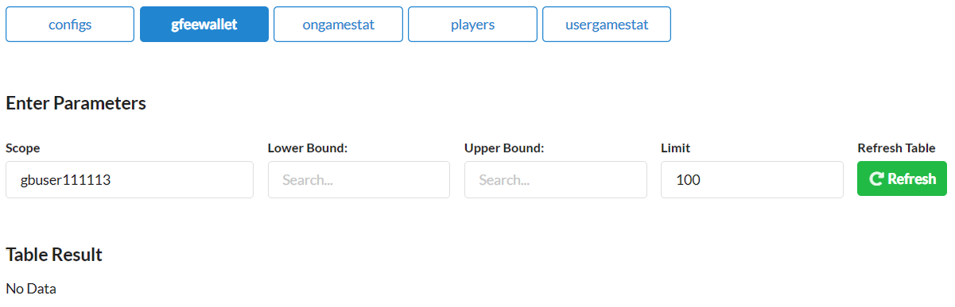
1.
gbuser111113
transfer desired cards to escrow contract
gpkbatescrow
Pre
Activity
Post
sassets
sassets
cardwallet
cardwallet
gfeewallet
gfeewallet

Slide 12
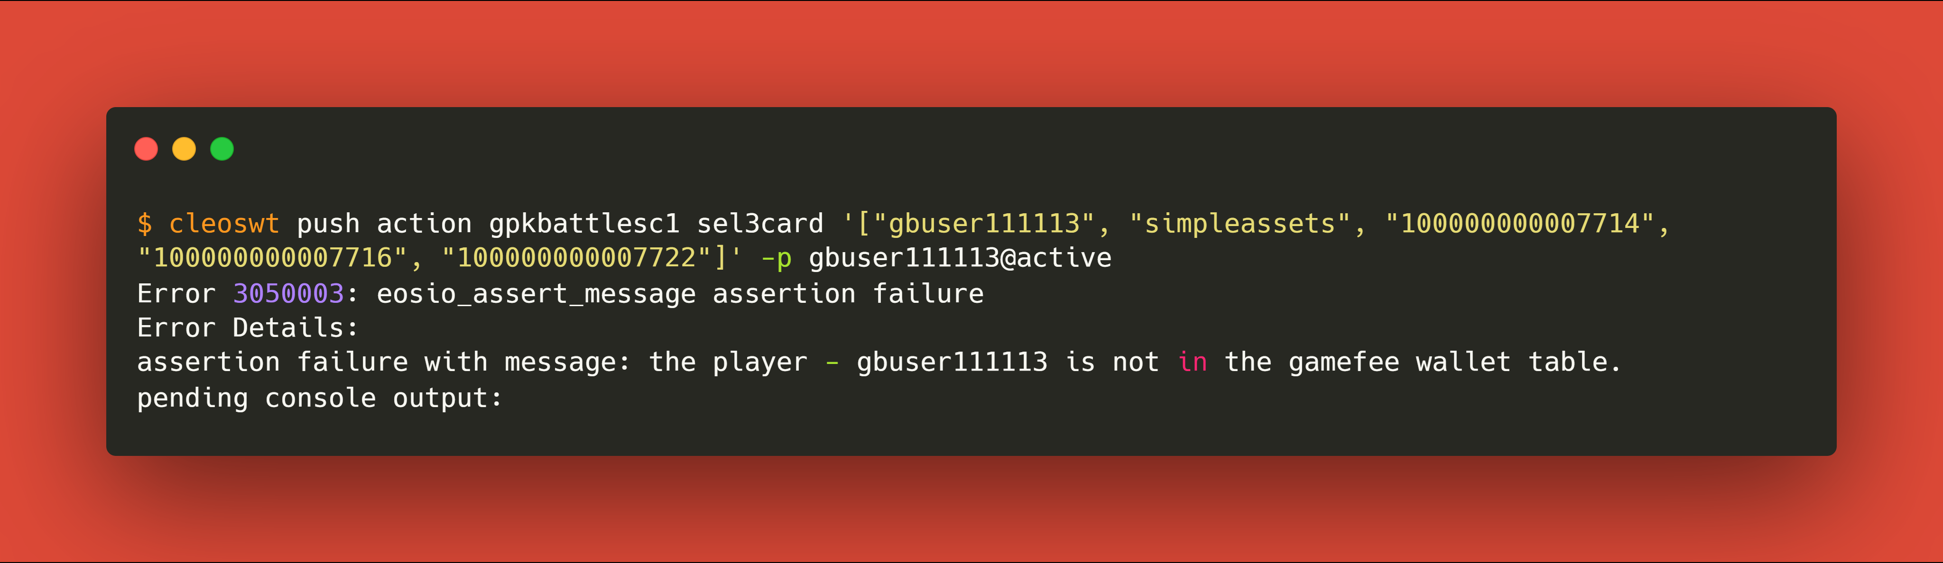

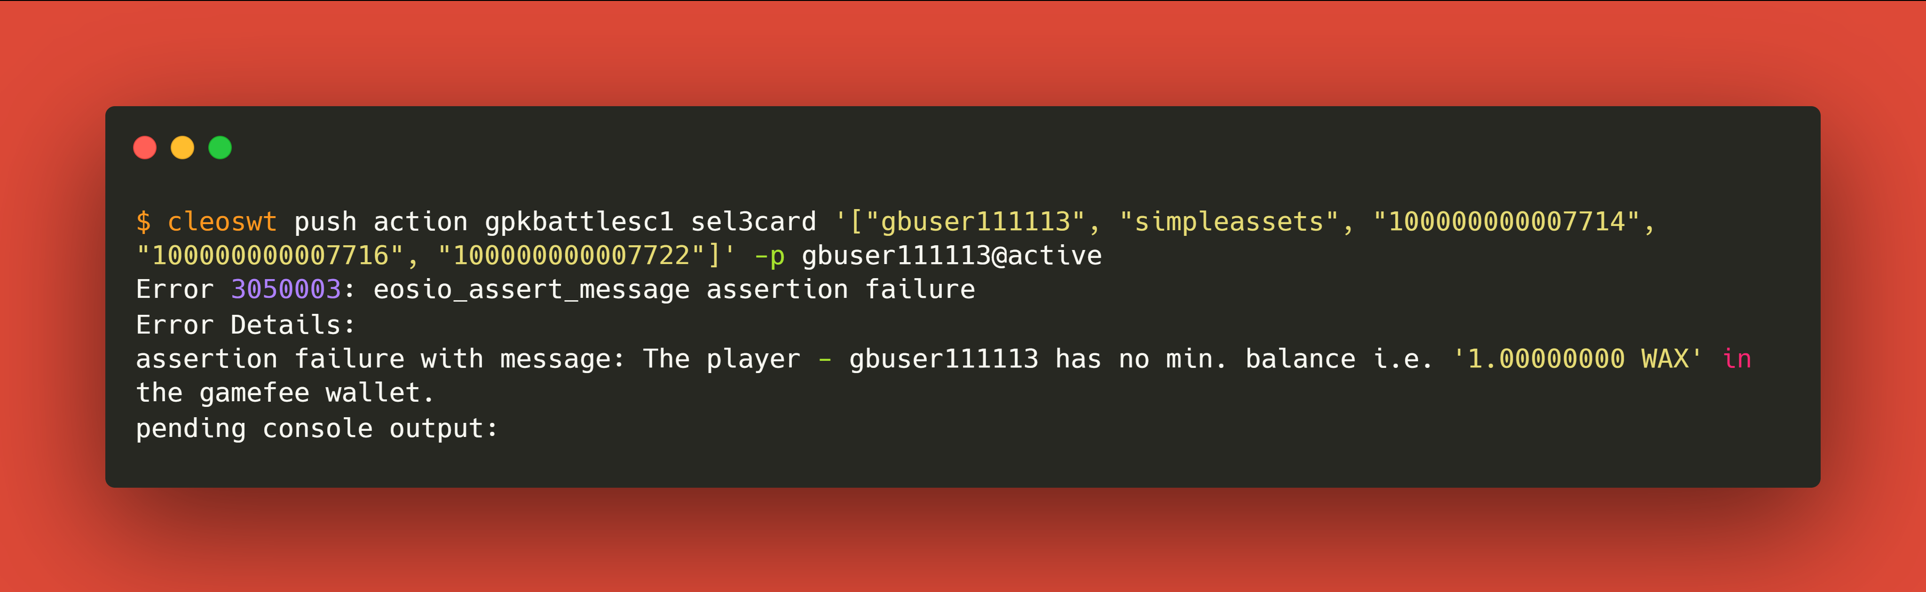
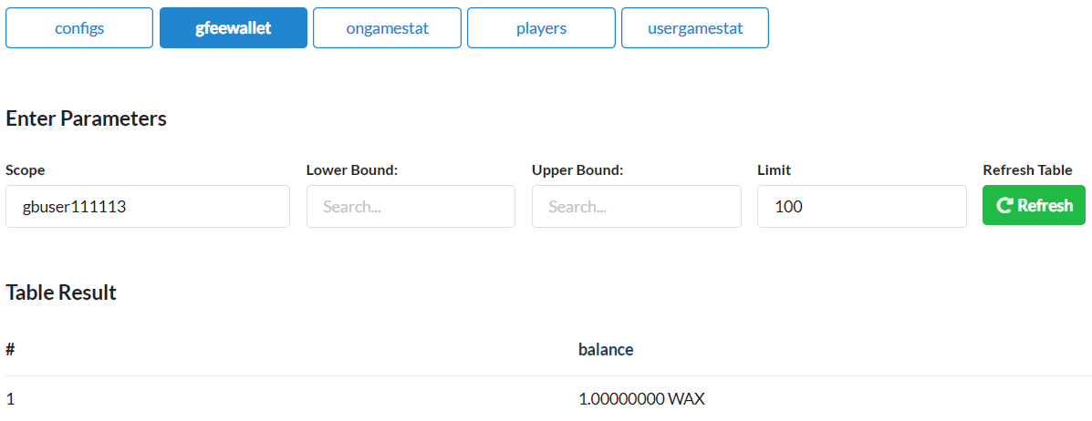
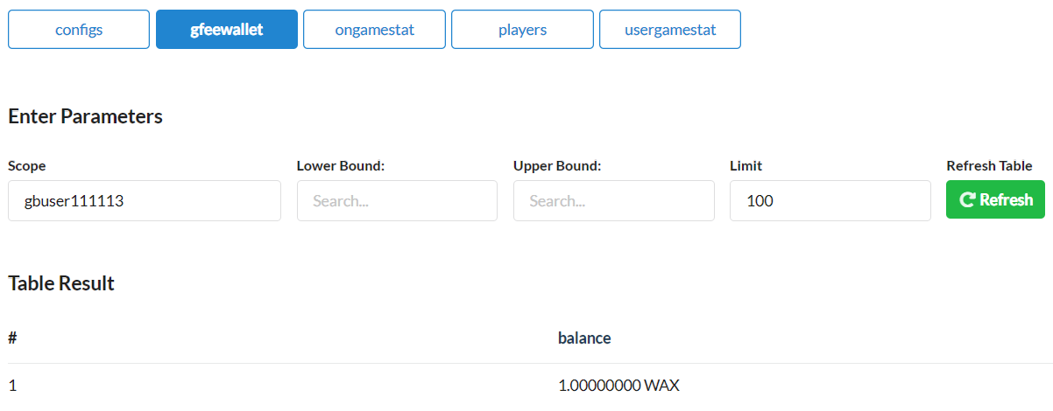
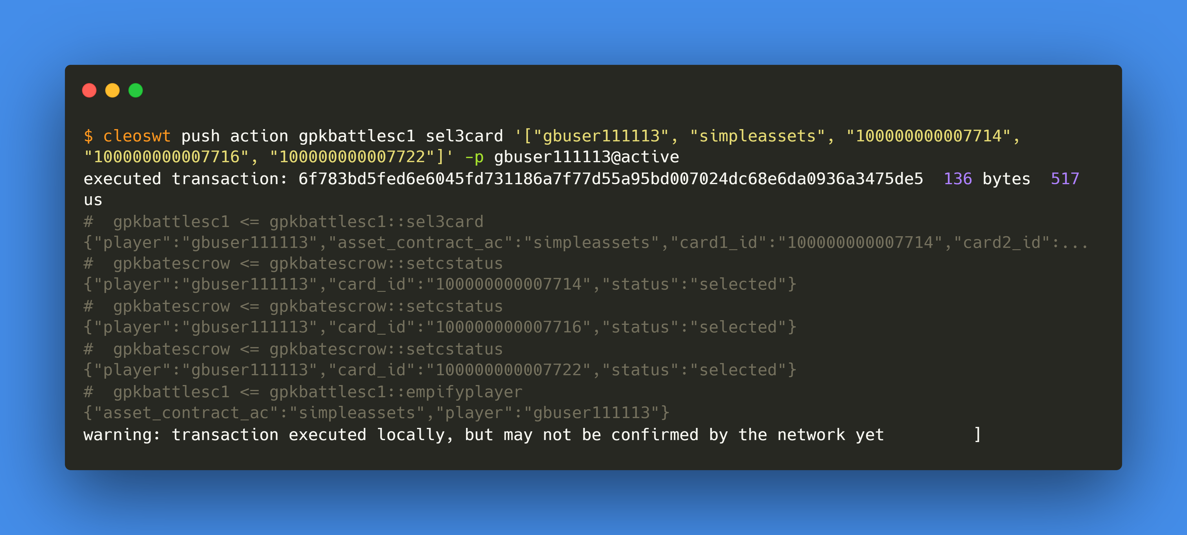
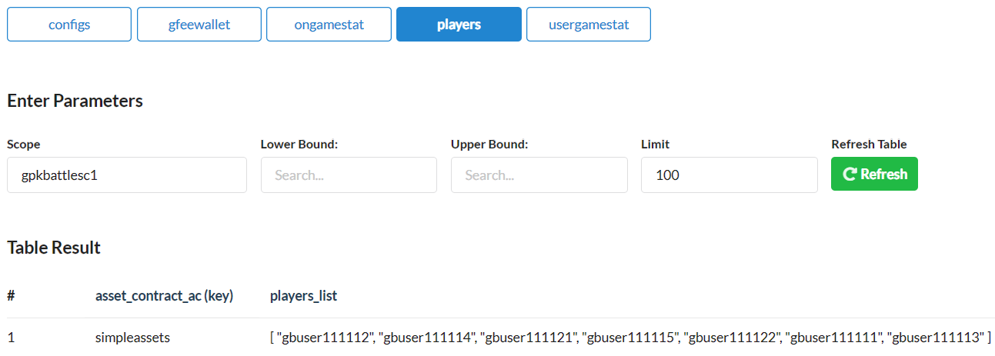
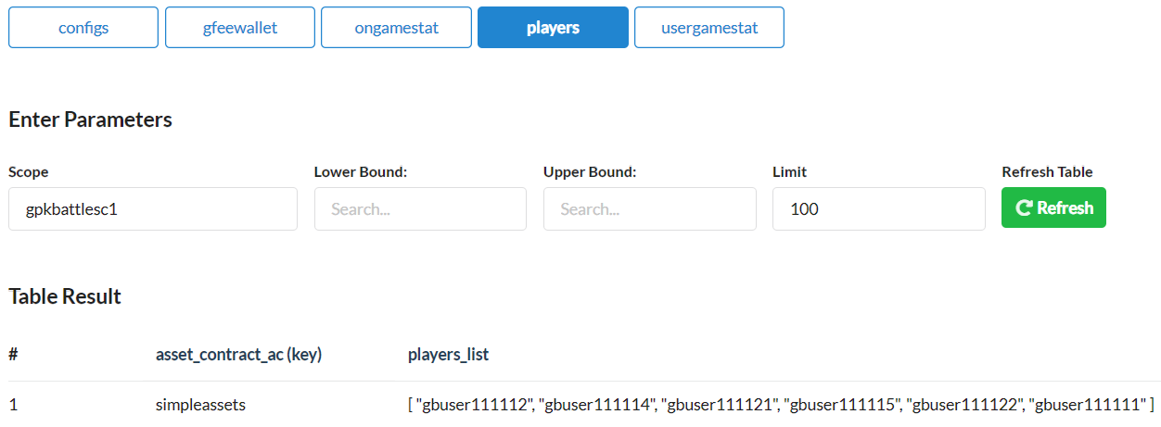
2.
gbuser111113
select 3 cards
Pre
Activity
Post
cardwallet
cardwallet
gfeewallet
gfeewallet
players
players

Slide 13

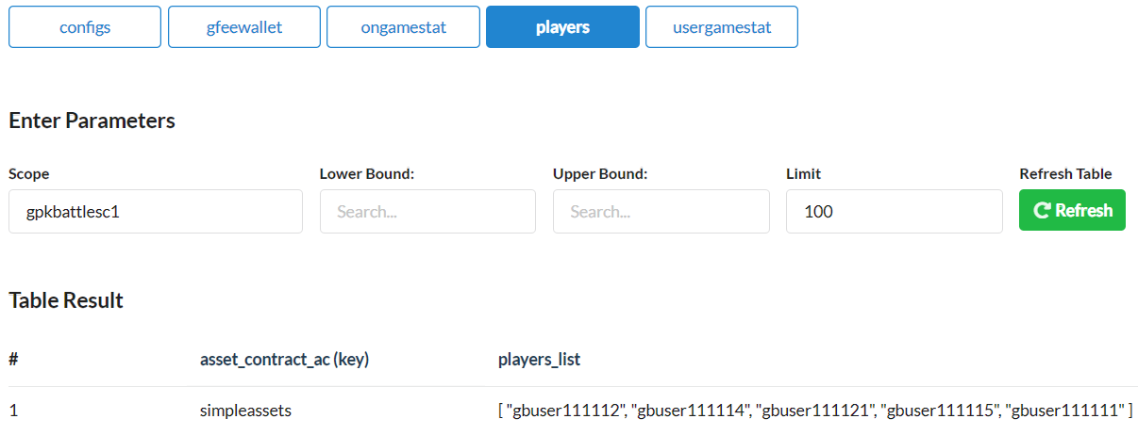
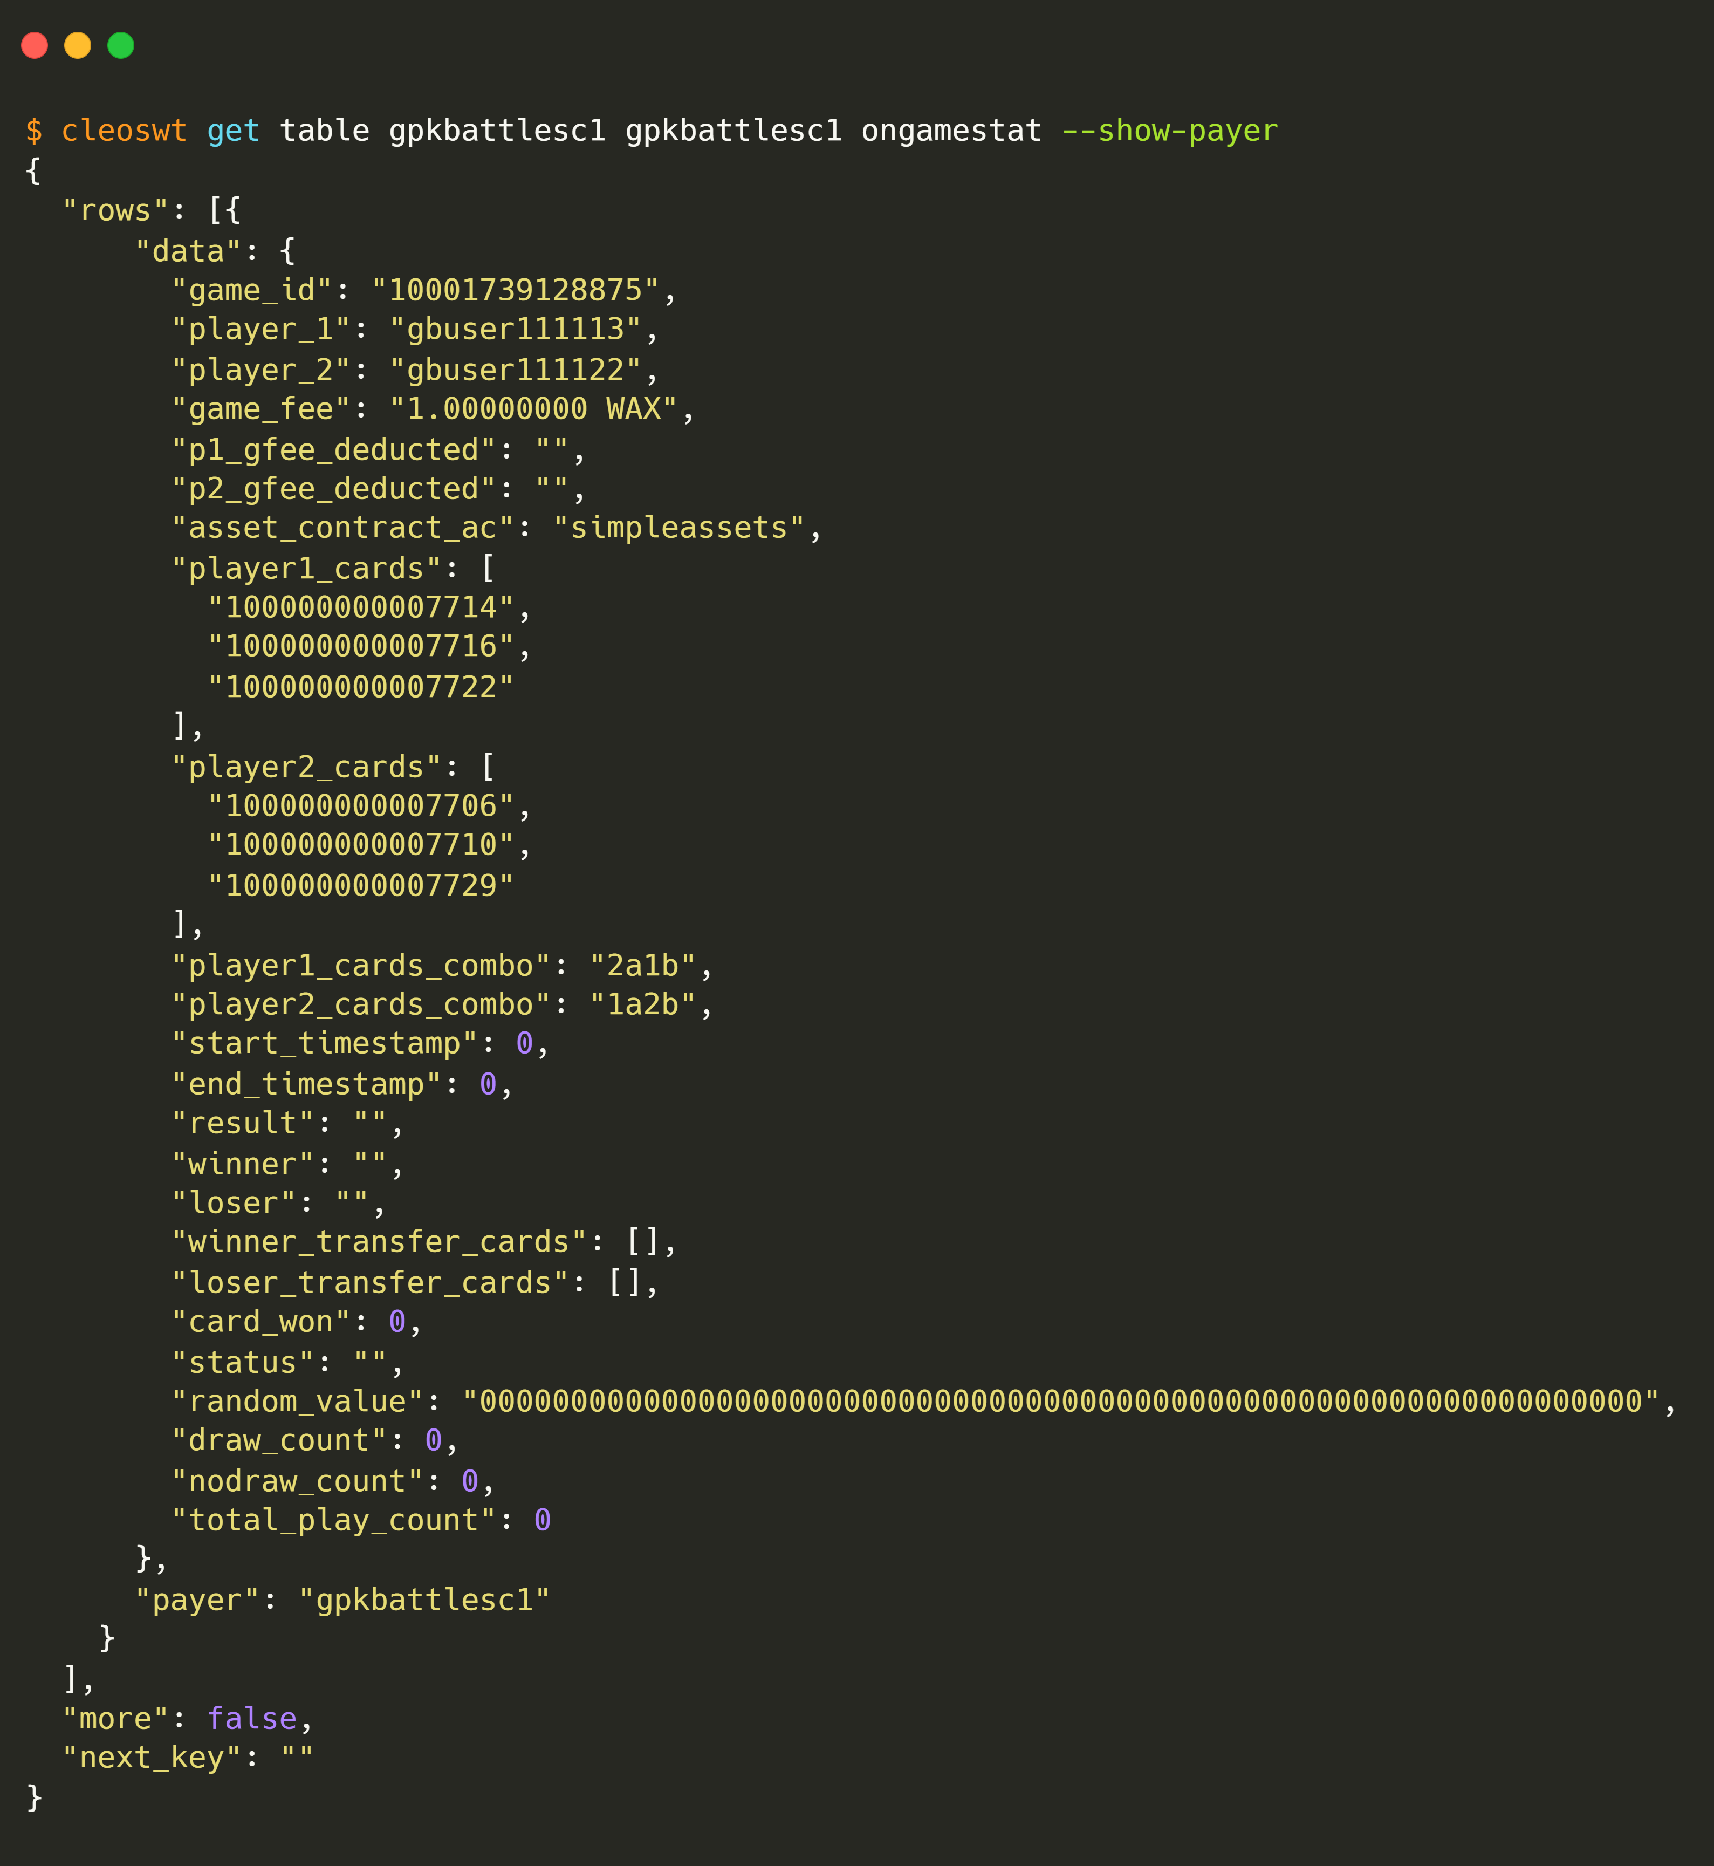
3.
gbuser111113
pairs with a player
Pre
Activity
Post
players
players
ongamestat
ongamestat
gfeewallet
gfeewallet

Slide 14
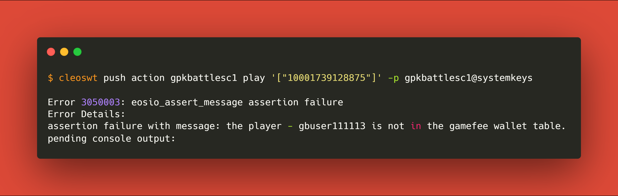
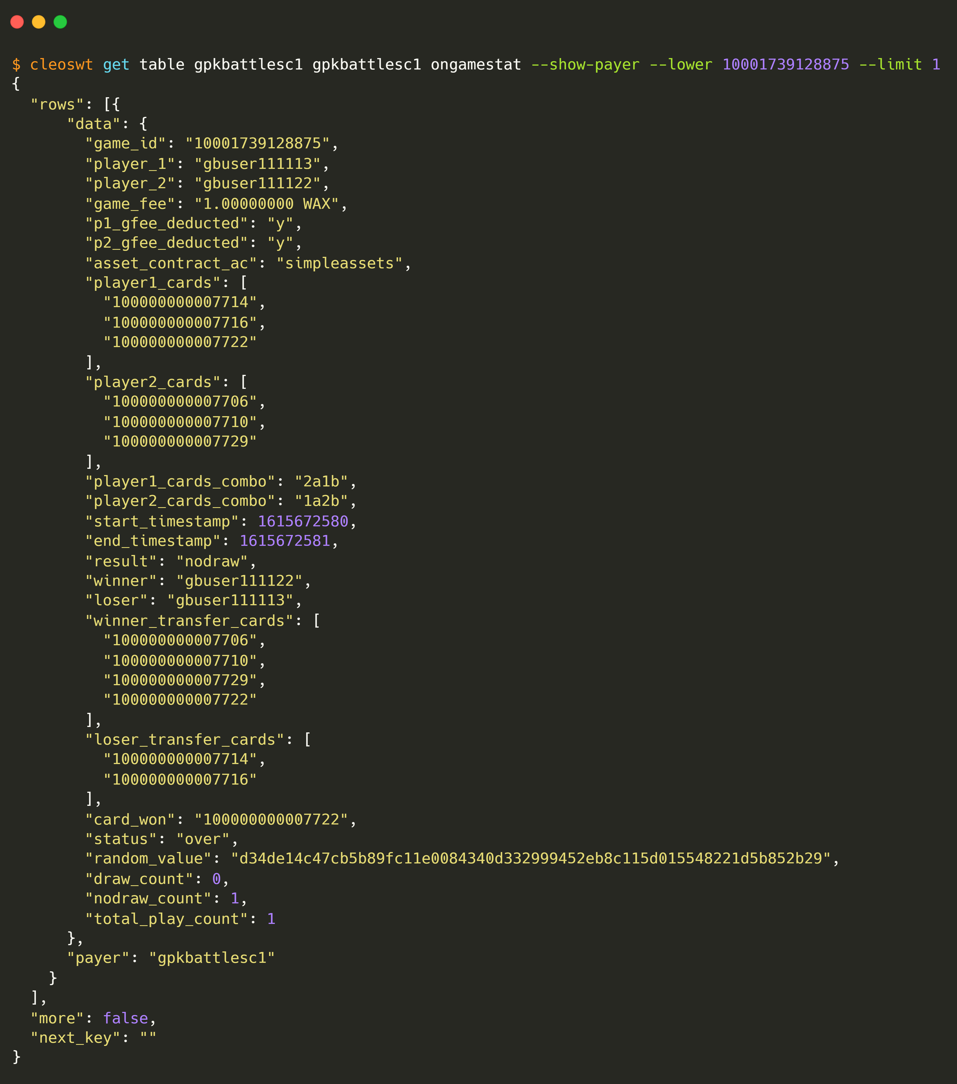




4.
gbuser111113
plays
Pre
Activity
Post
ongamestat
ongamestat
gfeewallet
gfeewallet

Slide 15








5.
Disburse nodraw cards by
gpkbattlesco
contract account
Pre
Activity
Post
ongamestat
accounts
ongamestat
accounts
players
players
usergamestat
cardwallet
cardwallet
usergamestat

Slide 16
RUN-3
Case-2.1: 1-draw >> 2-draw

Slide 17






1.
gbuser111115
transfer desired cards to escrow contract
gpkbatescrow
Pre
Activity
Post
sassets
sassets
cardwallet
cardwallet
gfeewallet
gfeewallet

Slide 18







2.
gbuser111115
select 3 cards
Pre
Activity
Post
cardwallet
cardwallet
gfeewallet
gfeewallet
players
players

Slide 19



3.
gbuser111115
pairs with a player
Pre
Activity
Post
players
players
ongamestat
ongamestat
gfeewallet
gfeewallet

Slide 20






4.
gbuser111115
plays
Pre
Activity
Post
ongamestat
ongamestat
gfeewallet
gfeewallet

Slide 21







5.
gbuser111115
gbuser111112
select 3 cards again
Pre
Activity
Post
cardwallet
cardwallet
gfeewallet
gfeewallet
players
players

Slide 22







6.
gbuser111115
play again for last time
Pre
Activity
Post
ongamestat
accounts
ongamestat
usergamestat
players
accounts
cardwallet
usergamestat
cardwallet
players

Slide 23

THANKS

